Slide 1
Log-binomial model for estimating the relative risk in cohort studies and clinical trials
Facilitated by
Md. Ahshanul Haque Maternal and Child Nutrition
Nutrition and Clinical Services Division
E-mail: ahshanul.haque@icddrb.org

Slide 2
Which regression is appropriate in this analysis
Outcome
Effect size

Slide 3
Which regression is appropriate in this analysis
Outcome
Study design
Effect size

Slide 4
Which regression is appropriate in this analysis
Outcome
Objective
Study design
Effect size

Slide 5
Which regression is appropriate in this analysis
Hypothesis
Outcome
Objective
Study design
Effect size

Slide 6
Which regression is appropriate in this analysis
Research Question
Hypothesis
Outcome
Objective
Study design
Effect size

Slide 7

Which regression is appropriate in this analysis
Research Question
Hypothesis
Outcome
Objective
Study design
Effect size

Slide 8
Research question and hypothesis testing
Is wearing mask associated with having COVID-19 positive in the people living in the Dhaka City, 2021
Notes:
Research Question

Slide 9
Research question and hypothesis testing
Is wearing mask associated with having COVID-19 positive in the people living in the Dhaka City, 2021
Notes:
Research Question

Slide 10
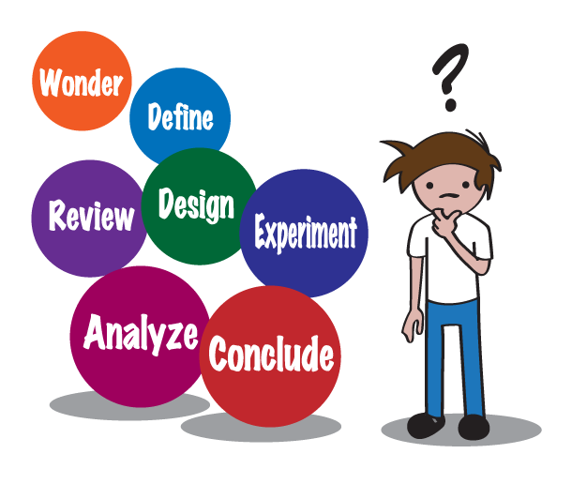
Research question and hypothesis testing
Is wearing mask associated with having COVID-19 positive in the people living in the Dhaka City, 2021
Not wearing mask is a most important factor with having COVID-19 positive
Notes:
Research Hypothesis

Slide 11
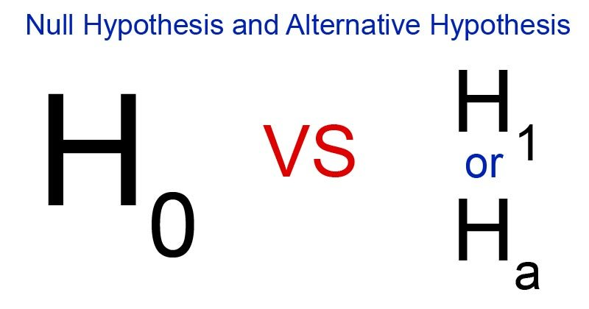
Research question and hypothesis testing
Is wearing mask associated with having COVID-19 positive in the people living in the Dhaka City, 2021
Not wearing mask is a most important factor with having COVID-19 positive
There is no association between wearing mask and having COVID-19 positive
Notes:
A null hypothesis is a type of hypothesis used in statistics that proposes that there is no difference between certain characteristics of a population

Slide 12
Research question and hypothesis testing
No difference
No Distance
No association
No relationship
No effect
No impact
Is wearing mask associated with having COVID-19 positive in the people living in the Dhaka City, 2021
Not wearing mask is a most important factor with having COVID-19 positive
There is no association between wearing mask and having COVID-19 positive
Notes:
A null hypothesis is a type of hypothesis used in statistics that proposes that there is no difference between certain characteristics of a population

Slide 13
Research question and hypothesis testing
No difference
No Distance
No association
No relationship
No effect
No impact
Is wearing mask associated with having COVID-19 positive in the people living in the Dhaka City, 2021
p1-p0=0
m1-m0=0
r=0
β=0
OR=1
RR=1
Wearing mask is the associated factor with having COVID-19 positive in the people living in the Dhaka City, 2021
There is no association between wearing mask and having COVID-19 positive
Notes:
A null hypothesis is a type of hypothesis used in statistics that proposes that there is no difference between certain characteristics of a population

Slide 14
Research question and hypothesis testing
Is wearing mask associated with having COVID-19 positive in the people living in the Dhaka City, 2021
Not wearing mask is a most important factor with having COVID-19 positive
There is no association between wearing mask and having COVID-19 positive
There is an association between wearing mask and having COVID-19 positive
Notes:
An alternative hypothesis is a statement that describes that there is a relationship between two selected variables in a study.

Slide 15
Research question and hypothesis testing
If we would like to test the difference of two proportion test
Then
H₀: p1=P2
H_{a}: P1≠P2
Or H_{a}: P1<P2
Or H_{a}: P1>P2
Is wearing mask associated with having COVID-19 positive in the people living in the Dhaka City, 2021
Wearing mask is the associated factor with having COVID-19 positive in the people living in the Dhaka City, 2021
There is no association between wearing mask and having COVID-19 positive
There is an association between not wearing mask and having COVID-19 positive

Slide 16
Research question and hypothesis testing
If we would like to test the difference of two mean test
Then
H₀: m1=m2
H_{a}: m1≠m2
Or H_{a}: m1<m2
Or H_{a}: m1>m2
Is wearing mask associated with having COVID-19 positive in the people living in the Dhaka City, 2021
Wearing mask is the associated factor with having COVID-19 positive in the people living in the Dhaka City, 2021
There is no association between wearing mask and having COVID-19 positive
There is an association between not wearing mask and having COVID-19 positive

Slide 17
Research question and hypothesis testing
If we would like to test odds ratio (OR) as strength of association
Then
H₀: OR=1
H_{a}: OR≠1
Or H_{a}: OR>1
Or H_{a}: OR<1
Is wearing mask associated with having COVID-19 positive in the people living in the Dhaka City, 2021
Wearing mask is the associated factor with having COVID-19 positive in the people living in the Dhaka City, 2021
There is no association between wearing mask and having COVID-19 positive
There is an association between not wearing mask and having COVID-19 positive

Slide 18
Research question and hypothesis testing
If we would like to test risk ratio (RR) as strength of association
Then
H₀: RR=1
H_{a}: RR≠1
Or H_{a}: RR>1
Or H_{a}: RR<1
Is wearing mask associated with having COVID-19 positive in the people living in the Dhaka City, 2021
Wearing mask is the associated factor with having COVID-19 positive in the people living in the Dhaka City, 2021
There is no association between wearing mask and having COVID-19 positive
There is an association between not wearing mask and having COVID-19 positive

Slide 19
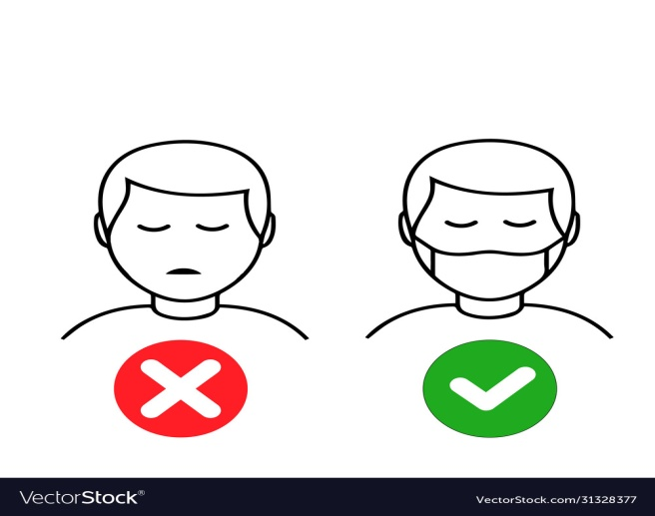


Regression
P1
P0

Slide 20
Regression
To test hypothesis:
P1=P0; Excess risk / Risk difference
P1/P0; Relative risk/ Risk ratio
Or any effect size
P1
P0

Slide 21
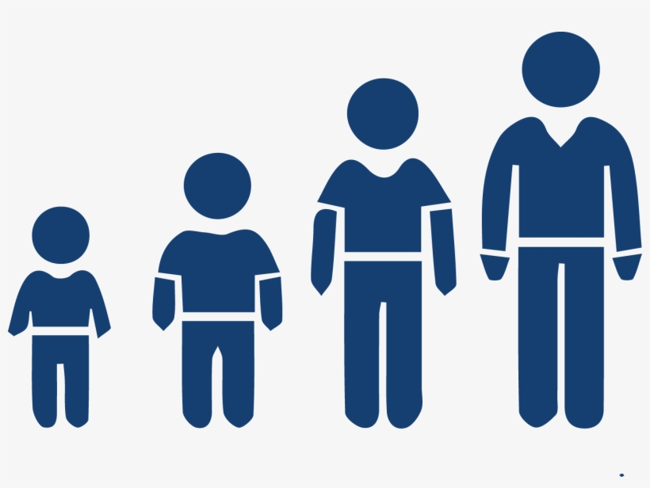
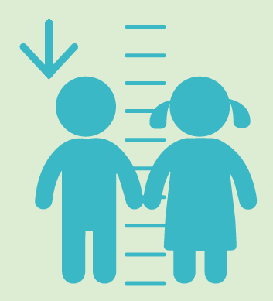




Regression

Slide 22
Regression
Did you wear mask | = | No
Age>40y | = | 40y
Sex | = | Male
Did you wash hand | = | No
SES | = | Rich
Educated | = | Higher
Ocupation | = | Service
Did you Maintain social Distance | = | Yes
P(Having Covid-19) | =

Slide 23
Regression
Did you wear mask | = | No
Age>40y | = | 40y
Sex | = | Male
Did you wash hand | = | No
SES | = | Rich
Educated | = | Higher
Ocupation | = | Service
Did you Maintain social Distance | = | Yes
P(Having Covid-19) | = | ???

Slide 24
Regression
Estimate the relationship that exists, on average, between the dependent variable and the independent variable (explanatory variable)
Determine the effect of each of the explanatory variable on the dependent variable, controlling the effects of all other explanatory variables
Predict the value of dependent variable for a given value of the explanatory variables

Slide 25


Type of regression
Linear regression
Log linear regression
Logistic regression
Probit regression
Poisson regression
Negative binomial regression
Cross sectional
Cohort
RCT
Case-control
Risk ratio/relative risk
Risk difference/ excess risk
Dependent variable is binary outcome

Slide 26
not wearing mask is a one of the most important factor of having COVID-19 positive among people living in the Dhaka City, 2022
Not wearing mask is a one of the most important Risk factor of having COVID-19 positive among people living in the Dhaka City, 2022

Slide 27
not wearing mask is a one of the most important factor of having COVID-19 positive among people living in the Dhaka City, 2022
Having COVID-19 positive
1 = Positive
0 = Negative
Not wearing mask
1 = Not wearing mask
0 = Wearing mask
Not wearing mask is one of the most important Risk factor of having COVID-19 positive among people living in the Dhaka City, 2022

Slide 28
Not wearing mask is one of the most important Risk factor of having COVID-19 positive among people living in the Dhaka City, 2022
not wearing mask is a one of the most important factor of having COVID-19 positive among people living in the Dhaka City, 2022
Study design: Prospective cohort

Slide 29
Not wearing mask is one of the most important Risk factor of having COVID-19 positive among people living in the Dhaka City, 2022
not wearing mask is a one of the most important factor of having COVID-19 positive among people living in the Dhaka City, 2022

Slide 30
Not wearing mask is one of the most important Risk factor of having COVID-19 positive among people living in the Dhaka City, 2022
not wearing mask is a one of the most important factor of having COVID-19 positive among people living in the Dhaka City, 2022

Slide 31
Not wearing mask is one of the most important Risk factor of having COVID-19 positive among people living in the Dhaka City, 2022
not wearing mask is a one of the most important factor of having COVID-19 positive among people living in the Dhaka City, 2022
Risk (p1)

Slide 32
Not wearing mask is one of the most important Risk factor of having COVID-19 positive among people living in the Dhaka City, 2022
not wearing mask is a one of the most important factor of having COVID-19 positive among people living in the Dhaka City, 2022
q1=1-p1
Risk (p1)

Slide 33
Not wearing mask is one of the most important Risk factor of having COVID-19 positive among people living in the Dhaka City, 2022
not wearing mask is a one of the most important factor of having COVID-19 positive among people living in the Dhaka City, 2022
q1=1-p1
Risk (p1)

Slide 34
Not wearing mask is one of the most important Risk factor of having COVID-19 positive among people living in the Dhaka City, 2022
q1=1-p1
Risk (p1)
q0=1-p0
Risk (p0)
Odds=p0/q0

Slide 35
Not wearing mask is one of the most important Risk factor of having COVID-19 positive among people living in the Dhaka City, 2022
q1=1-p1
Risk (p1)
q0=1-p0
Risk (p0)

Slide 36
Not wearing mask is a one of the most important Risk factor of having COVID-19 positive among people living in the Dhaka City, 2022
Risk (p1)
Risk (p0)

Slide 37
Not wearing mask is a one of the most important Risk factor of having COVID-19 positive among people living in the Dhaka City, 2022
Risk (p1)
Risk (p0)
Risk Ratio=p1/p0

Slide 38
Not wearing mask is a one of the most important Risk factor of having COVID-19 positive among people living in the Dhaka City, 2022
Risk (p1)
Risk (p0)
Risk Ratio=p1/p0
Risk Difference=p1-p0

Slide 39
Not wearing mask is a one of the most important Risk factor of having COVID-19 positive among people living in the Dhaka City, 2022
p1=0.6
p0=0.4
Risk (p1)
Risk (p0)
Risk Ratio=p1/p0
Risk Difference=p1-p0

Slide 40
Not wearing mask is a one of the most important Risk factor of having COVID-19 positive among people living in the Dhaka City, 2022
p1=0.6
p0=0.4
Risk (p1)
Risk (p0)
Risk Ratio=p1/p0
Risk Difference=p1-p0
Risk Ratio=0.6/0.4

Slide 41
Not wearing mask is a one of the most important Risk factor of having COVID-19 positive among people living in the Dhaka City, 2022
p1=0.6
p0=0.4
Risk (p1)
Risk (p0)
Risk Ratio=p1/p0
Risk Difference=p1-p0
Risk Ratio=0.6/0.4=1.5

Slide 42
Not wearing mask is a one of the most important Risk factor of having COVID-19 positive among people living in the Dhaka City, 2022
Risk (p1)
Risk (p0)
Risk Ratio=p1/p0
Risk Difference=p1-p0

Slide 43
Not wearing mask is a one of the most important Risk factor of having COVID-19 positive among people living in the Dhaka City, 2022
Risk (p1)
Risk (p0)
Risk Ratio=p1/p0
Risk Difference=p1-p0
H₀: RR=1; H₁: RR<1 or RR>1

Slide 44
Not wearing mask is a one of the most important Risk factor of having COVID-19 positive among people living in the Dhaka City, 2022
Risk (p1)
Risk (p0)
Risk Ratio=p1/p0
Risk Difference=p1-p0
H₀: RR=1; H₁: RR<1 or RR>1
How to test the hypothesis?

Slide 45
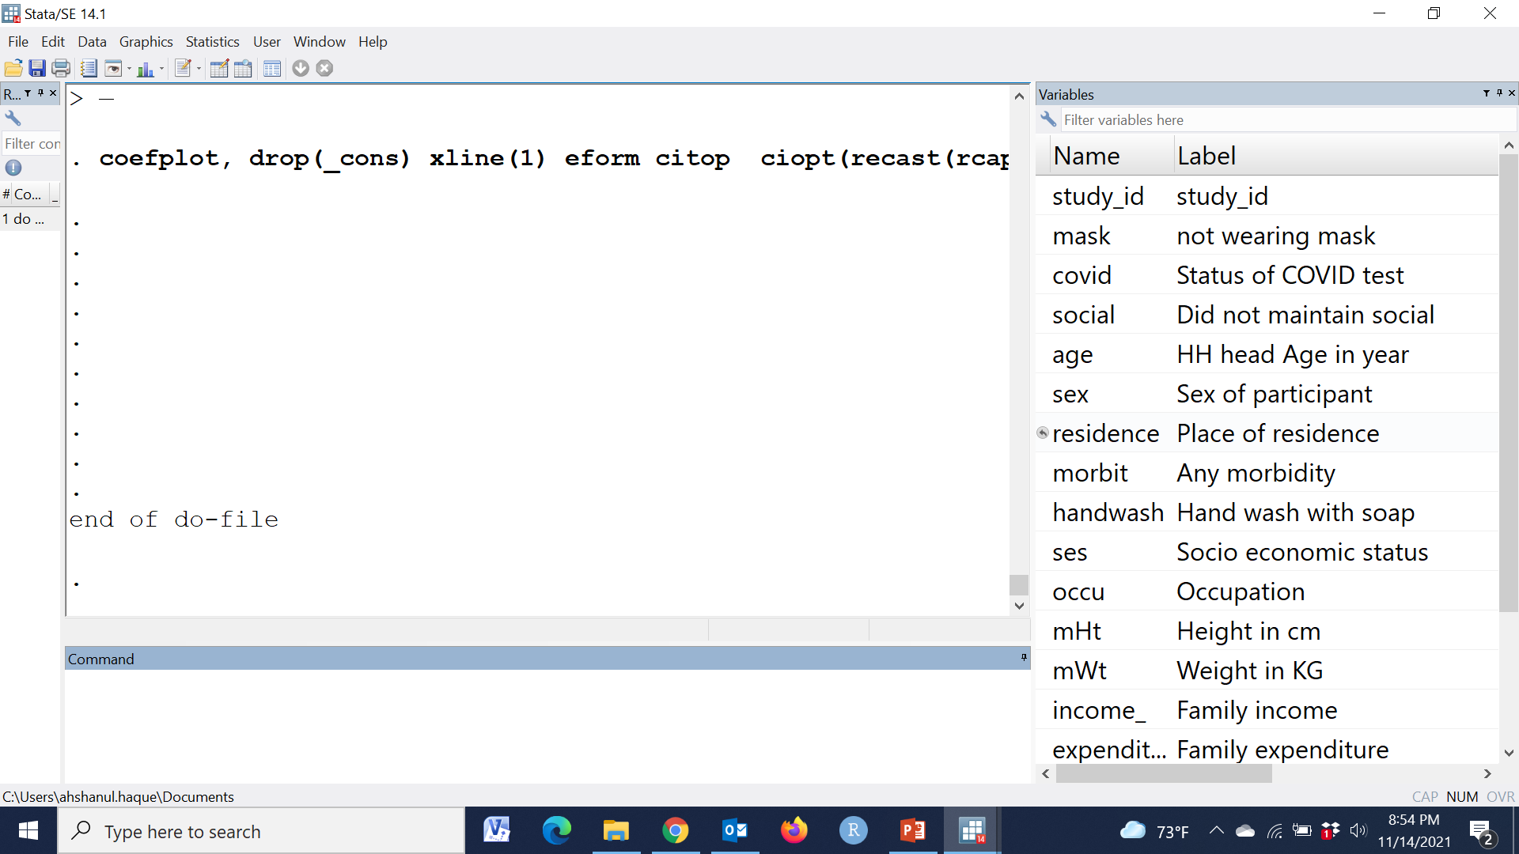

Slide 46
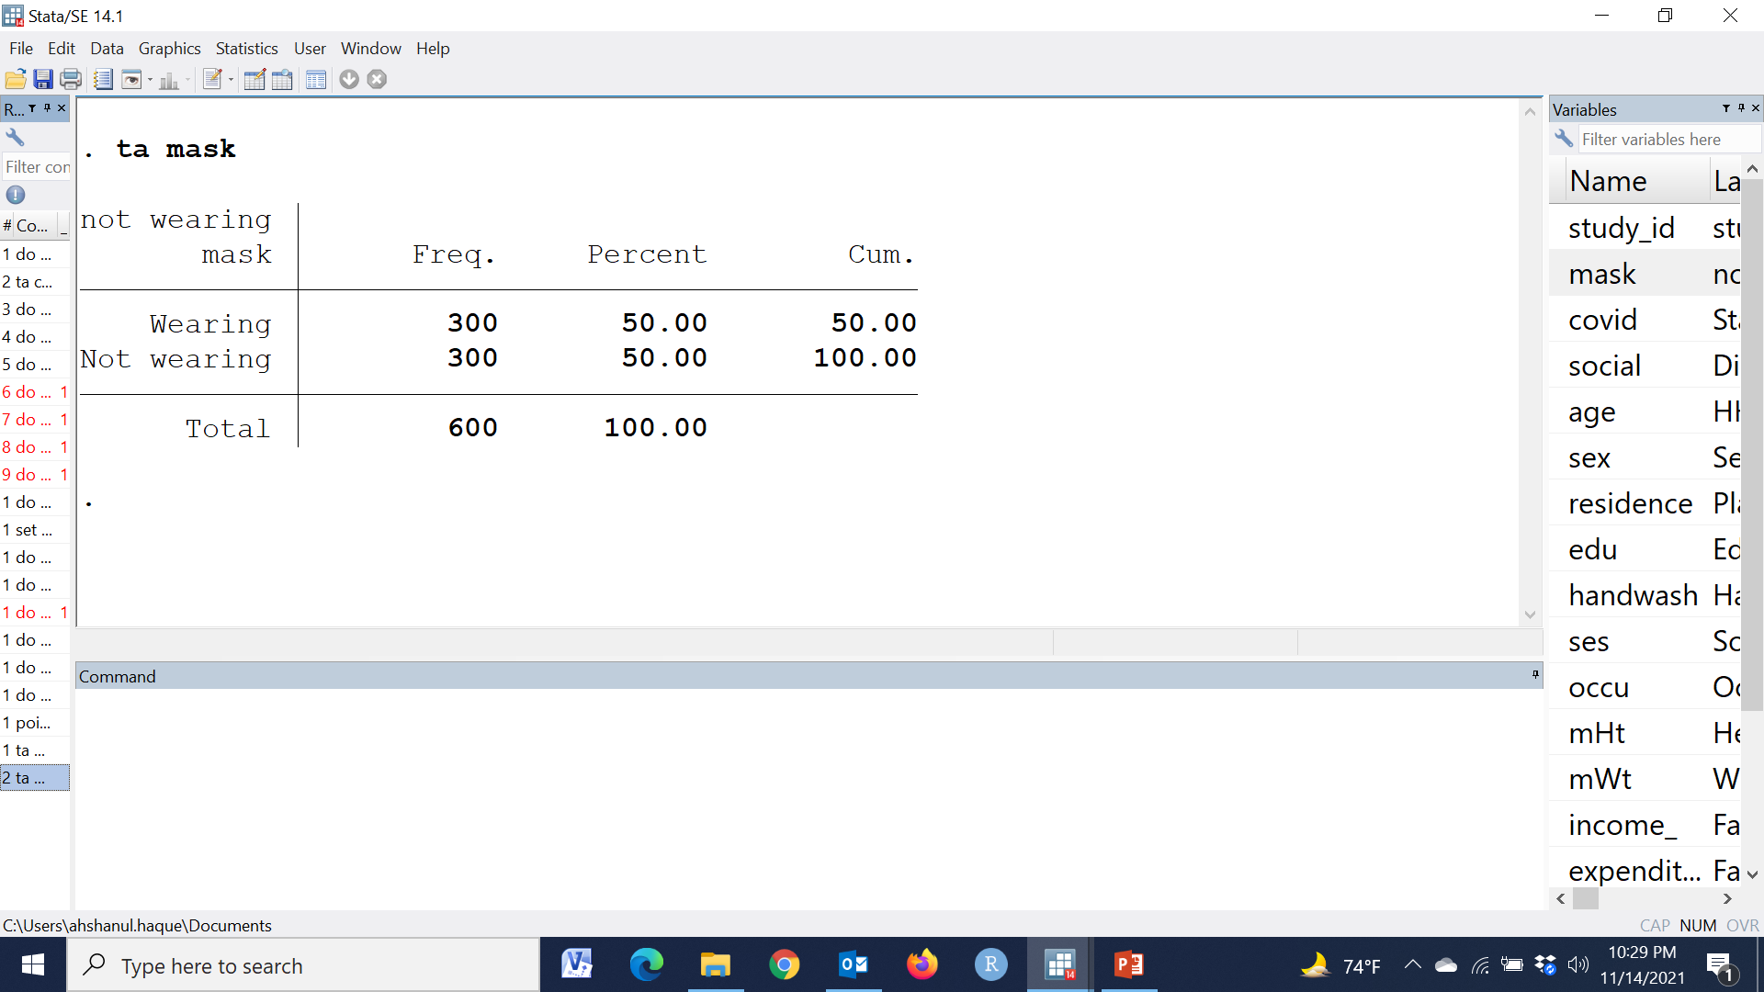
tab mask

Slide 47
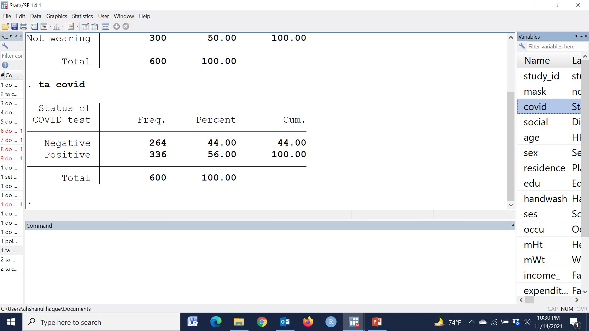
tab covid

Slide 48
tab covid mask, col ch

Slide 49
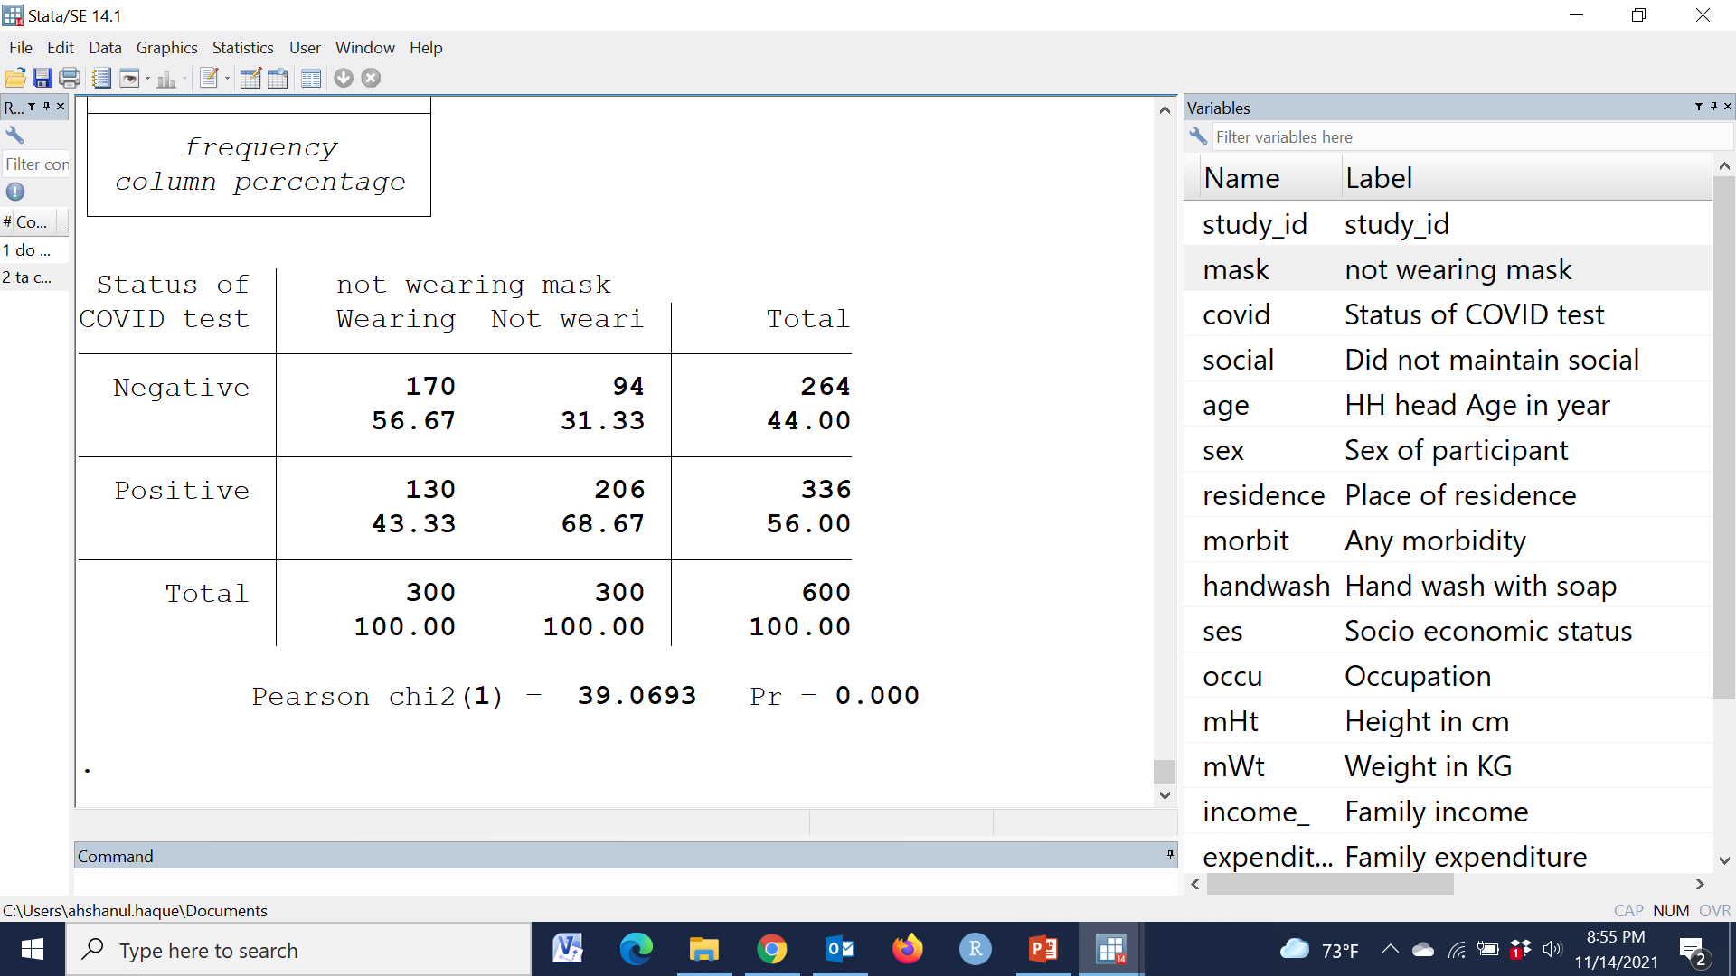
tab covid mask, col ch

Slide 50
tab covid mask, col ch
Risk (who didn’t wear)=68.67%
Risk (who wore)=

Slide 51
tab covid mask, col ch
Risk (who didn’t wear)=68.67%
Risk (who wore)=43.33%

Slide 52
tab covid mask, col ch
Risk (who didn’t wear)=68.67%
Risk (who wore)=43.33%
RR
=68.7 / 43.3
=1.58

Slide 53
 | Risk (who didn’t wear) | =1.58
 | Risk (who wore)
tab covid mask, col ch
Risk (who didn’t wear)=68.67%
Risk (who wore)=43.33%
RR
=68.7 / 43.3
=1.58

Slide 54
 | Risk (who didn’t wear) | =1.58
 | Risk (who wore)
tab covid mask, col ch
Risk (who didn’t wear)=68.67%
Risk (who wore)=43.33%
=> | Risk (who didn’t wear)=1.58* Risk (who wore)
RR
=68.7 / 43.3
=1.58

Slide 55
 | Risk (who didn’t wear) | =1.58
 | Risk (who wore)
tab covid mask, col ch
Risk (who didn’t wear)=68.67%
Risk (who wore)=43.33%
=> | Risk (who didn’t wear)=1.58* Risk (who wore)
RR
=68.7 / 43.3
=1.58
The risk of having COVID 19 was 1.58 time among the people who didn’t wear mask than the people who wore

Slide 56
 | Risk (who didn’t wear) | =1.58
 | Risk (who wore)
tab covid mask, col ch
Risk (who didn’t wear)=68.67%
Risk (who wore)=43.33%
=> | Risk (who didn’t wear)=1.58* Risk (who wore)
RR
=68.7 / 43.3
=1.58
P-value ????
Confidence interval ??
The risk of having COVID 19 was 1.58 time among the people who didn’t wear mask than the people who wore

Slide 57
Proportion/Risk will calculated using 2 x 2 table/ Cross table
Log linear regression
RR will be calculated easily
P-value will be estimated
95% Confidence Interval will be estimated
Other relevant variables will be adjusted

Slide 58
Proportion/Risk will calculated using 2 x 2 table/ Cross table
Log linear regression
RR will be calculated easily
P-value will be estimated
95% Confidence Interval will be estimated
Other relevant variables will be adjusted

Slide 59
Log linear regression
Having COVID-19 positive ~ Not wearing mask
Having COVID-19 positive
1 = Positive
0 = Negative
Not wearing mask
1 = Not wearing mask
0 = Wearing mask
Outcome variable is binary

Slide 60
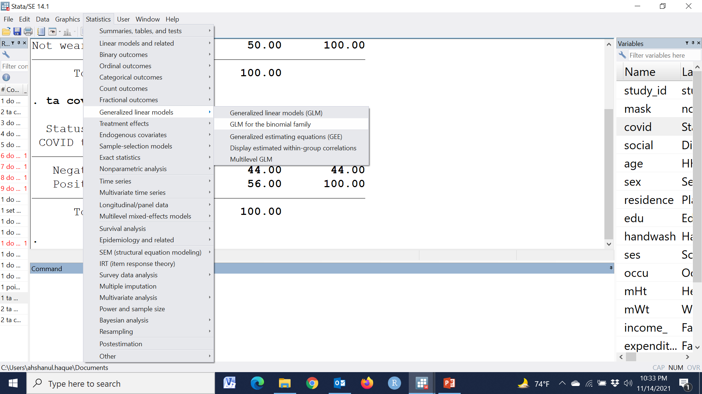

Slide 62
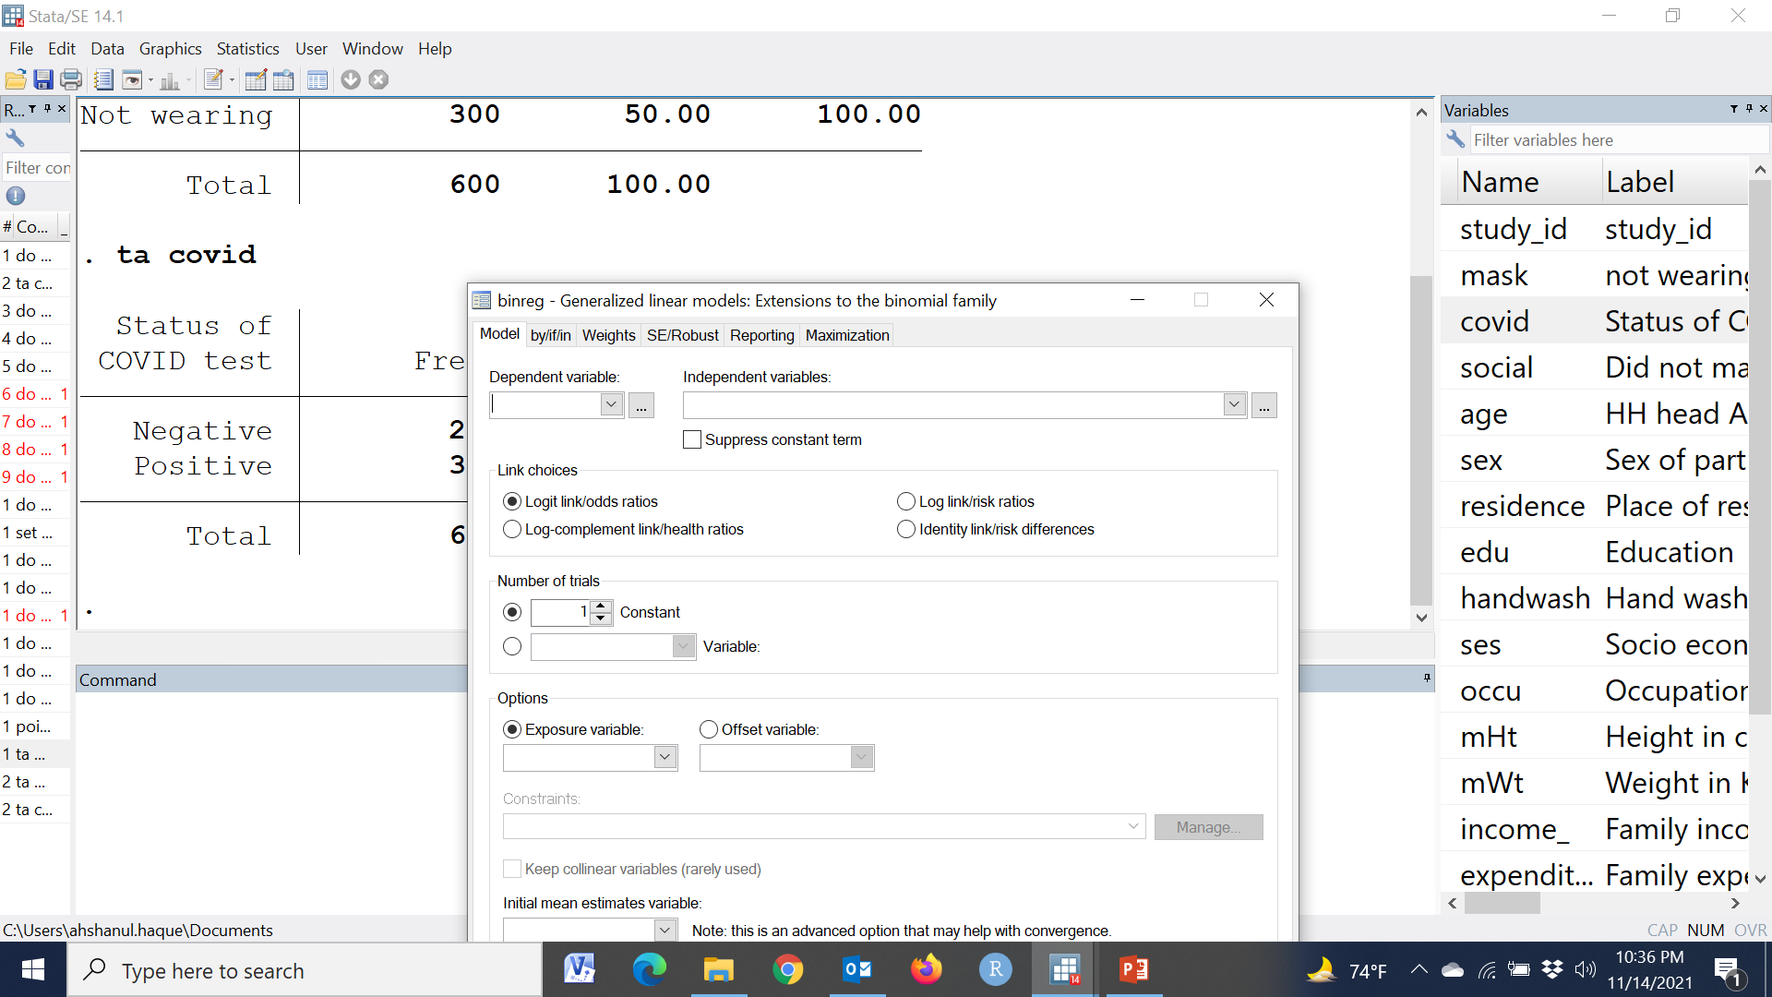

Slide 63


Slide 65
binreg covid ib0.mask, rr

Slide 66
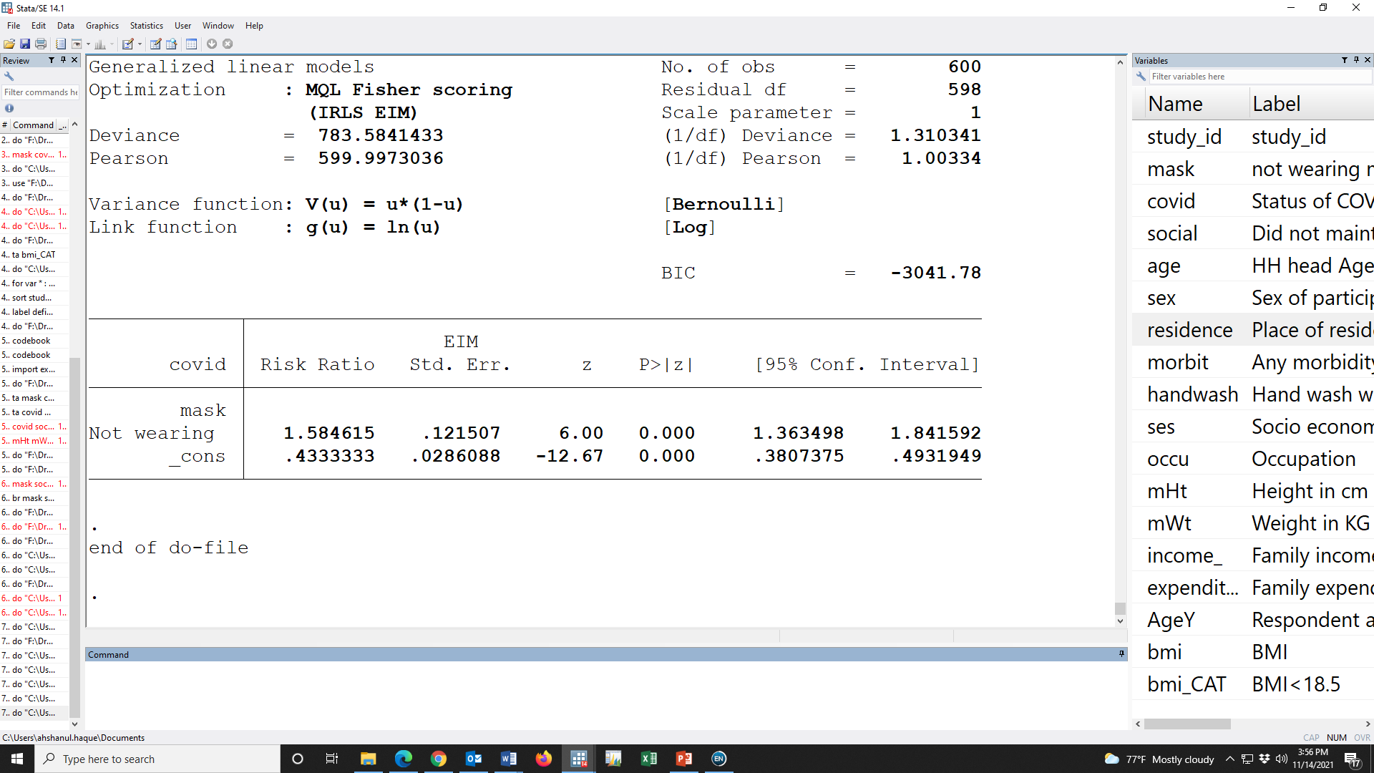

Slide 67
Having COVID-19 positive
1 = Positive
0 = Negative
Not wearing mask
1 = Not wearing mask
0 = Wearing mask

Slide 68
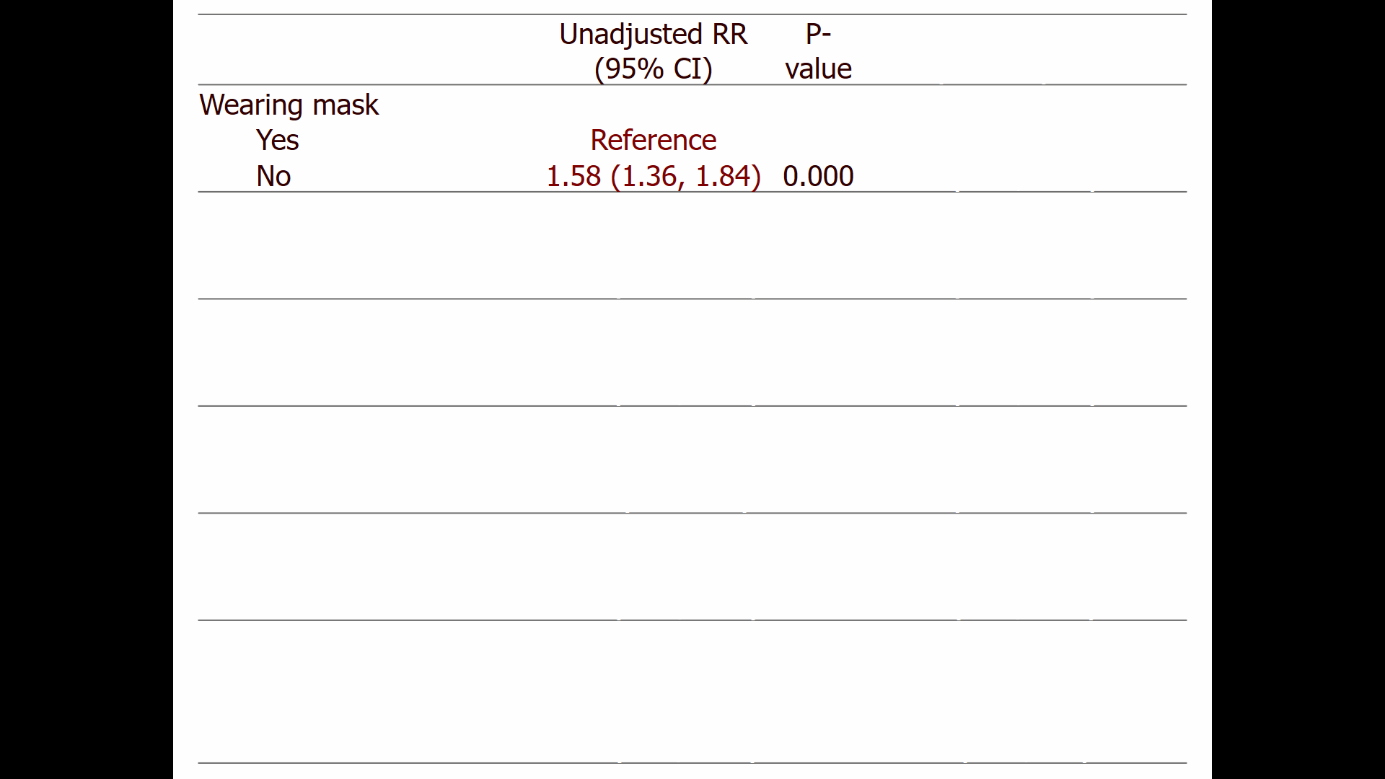
Having COVID-19 positive
1 = Positive
0 = Negative
Not wearing mask
1 = Not wearing mask
0 = Wearing mask

Slide 69
 |  | Unadjusted RR (95% CI) | P-value | Adjusted RR (95% CI) | P-value
Wearing mask
 | Yes | Reference |  | Reference
 | No | 1.58 (1.36, 1.84) | 0.000 | 1.43 (1.23, 1.65) | 0.000
Maintained social distance
 | Yes | Reference |  | Reference
 | No | 1.41 (1.22, 1.63) | 0.000 | 1.32 (1.16, 1.51) | 0.000
Age in year
 | <30Y | Reference |  | Reference
 | >=30Y | 1.02 (0.89, 1.18) | 0.762 | 1.06 (0.94, 1.19) | 0.332
Sex of participant
 | Male | Reference |  | Reference
 | Female | 1.02 (0.87, 1.2) | 0.784 | 1.01 (0.88, 1.15) | 0.917
Handwash
 | No | Reference |  | Reference
 | Yes | 0.62 (0.52, 0.72) | 0.000 | 0.67 (0.57, 0.78) | 0.000
Occupation
 | None | Reference |  | Reference
 | Service | 1.07 (0.87, 1.31) | 0.501 | 0.94 (0.79, 1.12) | 0.502
 | Business | 1.04 (0.87, 1.24) | 0.655 | 0.95 (0.81, 1.10) | 0.482

Slide 70
 |  | Unadjusted RR (95% CI) | P-value | Adjusted RR (95% CI) | P-value
Wearing mask
 | Yes | Reference |  | Reference
 | No | 1.58 (1.36, 1.84) | 0.000 | 1.43 (1.23, 1.65) | 0.000
Maintained social distance
 | Yes | Reference |  | Reference
 | No | 1.41 (1.22, 1.63) | 0.000 | 1.32 (1.16, 1.51) | 0.000
Age in year
 | <30Y | Reference |  | Reference
 | >=30Y | 1.02 (0.89, 1.18) | 0.762 | 1.06 (0.94, 1.19) | 0.332
Sex of participant
 | Male | Reference |  | Reference
 | Female | 1.02 (0.87, 1.2) | 0.784 | 1.01 (0.88, 1.15) | 0.917
Handwash
 | No | Reference |  | Reference
 | Yes | 0.62 (0.52, 0.72) | 0.000 | 0.67 (0.57, 0.78) | 0.000
Occupation
 | None | Reference |  | Reference
 | Service | 1.07 (0.87, 1.31) | 0.501 | 0.94 (0.79, 1.12) | 0.502
 | Business | 1.04 (0.87, 1.24) | 0.655 | 0.95 (0.81, 1.10) | 0.482
The risk of having COVID 19 was 1.58 time among the people who didn’t wear mask than the people who wore

Slide 71
 |  | Unadjusted RR (95% CI) | P-value | Adjusted RR (95% CI) | P-value
Wearing mask
 | Yes | Reference |  | Reference
 | No | 1.58 (1.36, 1.84) | 0.000 | 1.43 (1.23, 1.65) | 0.000
Maintained social distance
 | Yes | Reference |  | Reference
 | No | 1.41 (1.22, 1.63) | 0.000 | 1.32 (1.16, 1.51) | 0.000
Age in year
 | <30Y | Reference |  | Reference
 | >=30Y | 1.02 (0.89, 1.18) | 0.762 | 1.06 (0.94, 1.19) | 0.332
Sex of participant
 | Male | Reference |  | Reference
 | Female | 1.02 (0.87, 1.2) | 0.784 | 1.01 (0.88, 1.15) | 0.917
Handwash
 | No | Reference |  | Reference
 | Yes | 0.62 (0.52, 0.72) | 0.000 | 0.67 (0.57, 0.78) | 0.000
Occupation
 | None | Reference |  | Reference
 | Service | 1.07 (0.87, 1.31) | 0.501 | 0.94 (0.79, 1.12) | 0.502
 | Business | 1.04 (0.87, 1.24) | 0.655 | 0.95 (0.81, 1.10) | 0.482
The risk of having COVID 19 was 1.58 [RR: 1.58 (95% CI: 1:36, 1:84); p-value<0.001] time among the people who didn’t wear mask than the people who wore

Slide 72
 |  | Unadjusted RR (95% CI) | P-value | Adjusted RR (95% CI) | P-value
Wearing mask
 | Yes | Reference |  | Reference
 | No | 1.58 (1.36, 1.84) | 0.000 | 1.43 (1.23, 1.65) | 0.000
Maintained social distance
 | Yes | Reference |  | Reference
 | No | 1.41 (1.22, 1.63) | 0.000 | 1.32 (1.16, 1.51) | 0.000
Age in year
 | <30Y | Reference |  | Reference
 | >=30Y | 1.02 (0.89, 1.18) | 0.762 | 1.06 (0.94, 1.19) | 0.332
Sex of participant
 | Male | Reference |  | Reference
 | Female | 1.02 (0.87, 1.2) | 0.784 | 1.01 (0.88, 1.15) | 0.917
Handwash
 | No | Reference |  | Reference
 | Yes | 0.62 (0.52, 0.72) | 0.000 | 0.67 (0.57, 0.78) | 0.000
Occupation
 | None | Reference |  | Reference
 | Service | 1.07 (0.87, 1.31) | 0.501 | 0.94 (0.79, 1.12) | 0.502
 | Business | 1.04 (0.87, 1.24) | 0.655 | 0.95 (0.81, 1.10) | 0.482
The risk of having COVID 19 was 1.58 [RR: 1.58 (95% CI: 1:36, 1:84); p-value<0.001] time among the people who didn’t wear mask than the people who wore which indicates that not wearing mask was significantly associated with having COVID-19 positive

Slide 73
Exposure
Outcome

Slide 78
Log linear regression
Having COVID-19 positive ~ Not wearing mask
Having COVID-19 positive ~ Did not maintain social distance
Having COVID-19 positive ~ Age in year
Having COVID-19 positive ~ Sex of participant
Having COVID-19 positive ~ Handwash
Having COVID-19 positive ~ Occupation

Slide 79
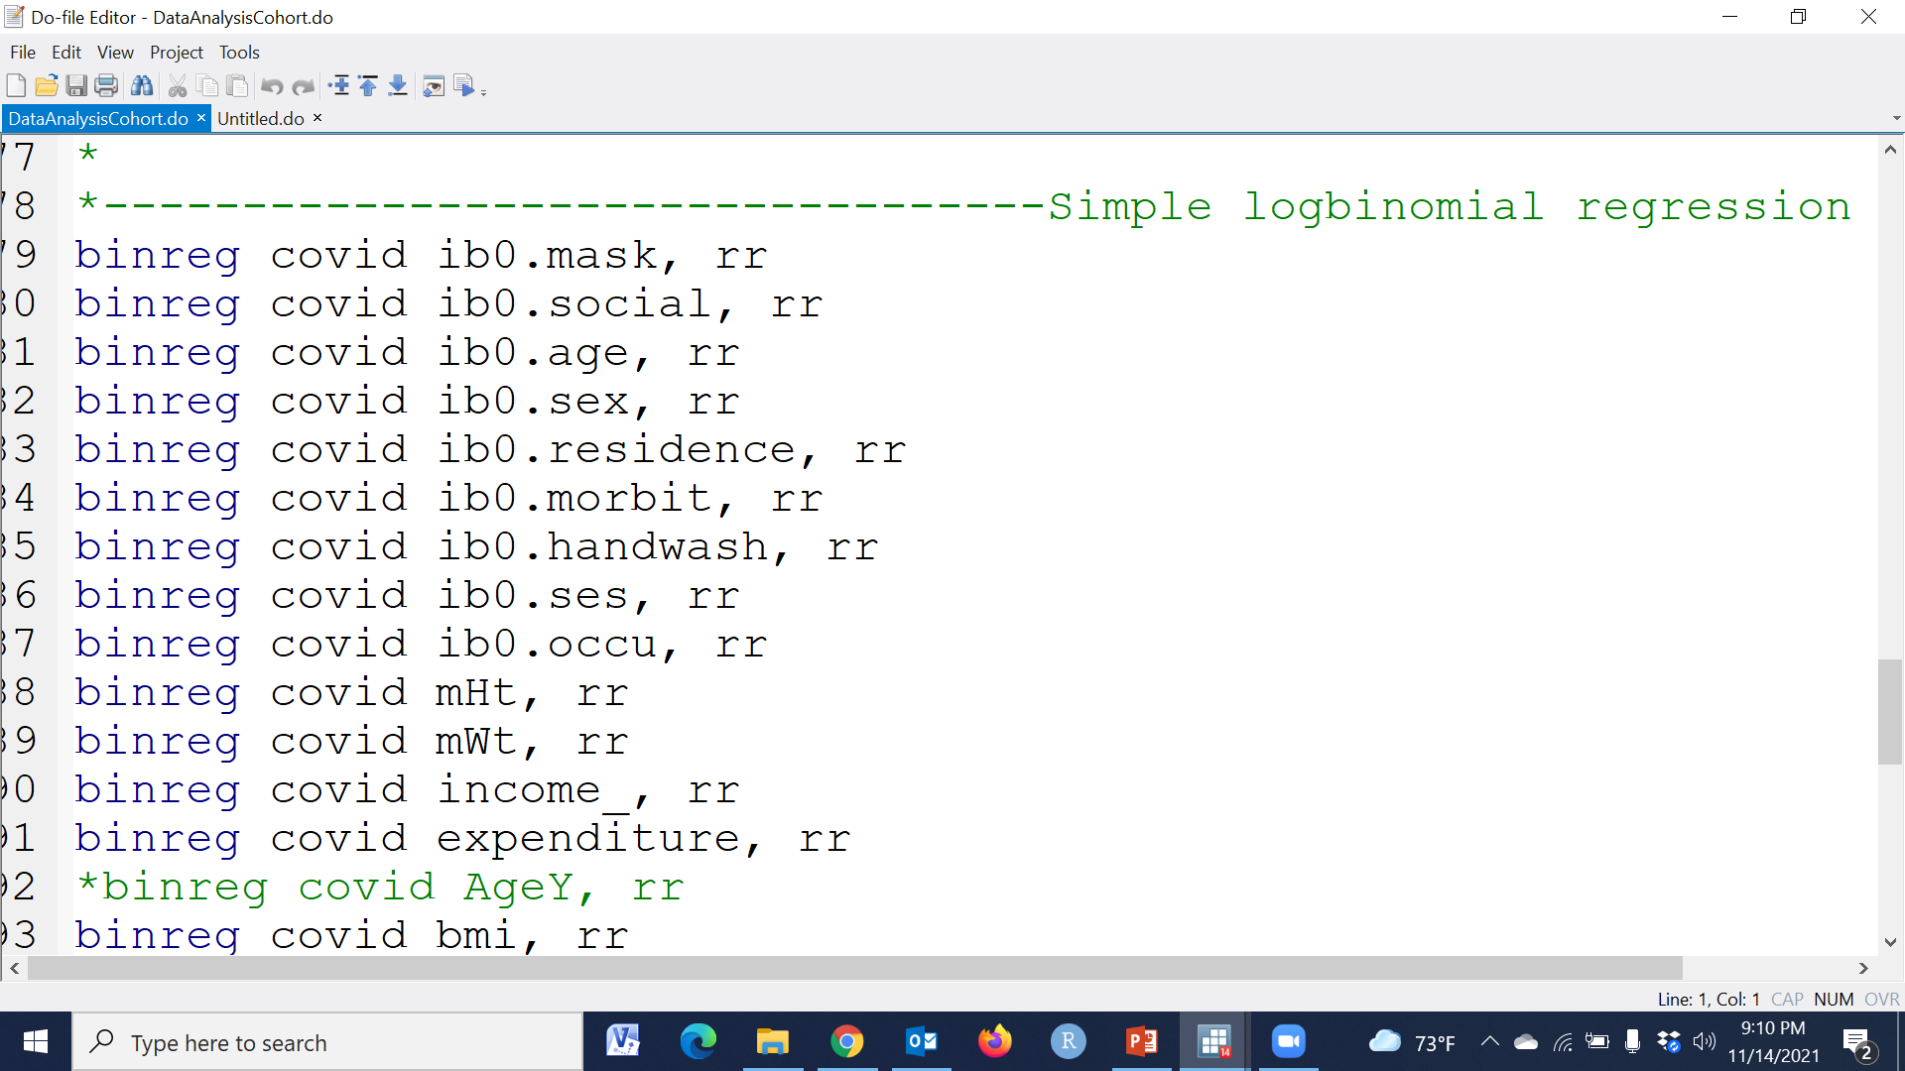

Slide 80
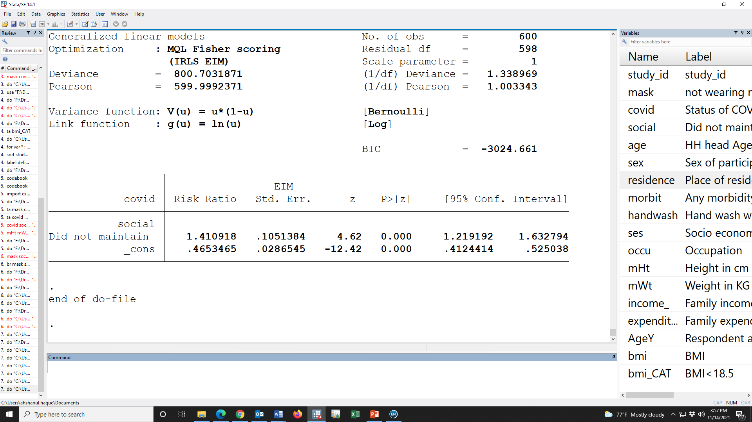
Did not maintained
1 = Did not maintain
0 = Maintained

Slide 81
 |  | Unadjusted RR (95% CI) | P-value | Adjusted RR (95% CI) | P-value
Wearing mask
 | Yes | Reference |  | Reference
 | No | 1.58 (1.36, 1.84) | 0.000 | 1.43 (1.23, 1.65) | 0.000
Maintained social distance
 | Yes | Reference |  | Reference
 | No | 1.41 (1.22, 1.63) | 0.000 | 1.32 (1.16, 1.51) | 0.000
Age in year
 | <30Y | Reference |  | Reference
 | >=30Y | 1.02 (0.89, 1.18) | 0.762 | 1.06 (0.94, 1.19) | 0.332
Sex of participant
 | Male | Reference |  | Reference
 | Female | 1.02 (0.87, 1.2) | 0.784 | 1.01 (0.88, 1.15) | 0.917
Handwash
 | No | Reference |  | Reference
 | Yes | 0.62 (0.52, 0.72) | 0.000 | 0.67 (0.57, 0.78) | 0.000
Occupation
 | None | Reference |  | Reference
 | Service | 1.07 (0.87, 1.31) | 0.501 | 0.94 (0.79, 1.12) | 0.502
 | Business | 1.04 (0.87, 1.24) | 0.655 | 0.95 (0.81, 1.10) | 0.482

Slide 82
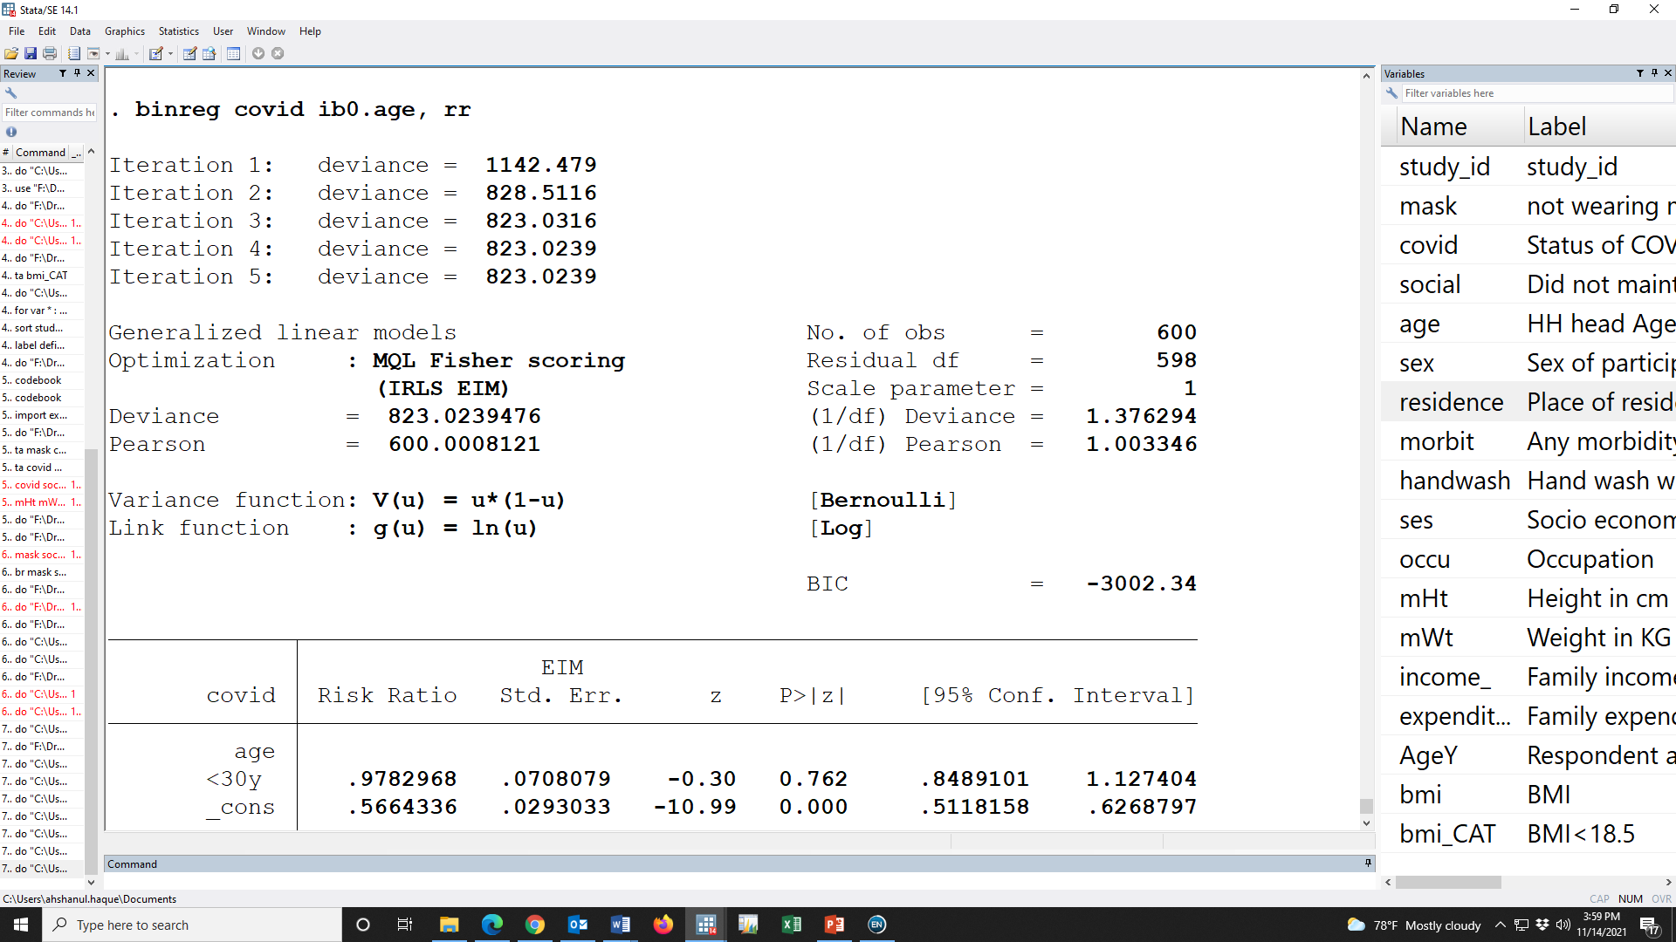
Age group
1 = >=30y
0 = <30y

Slide 83
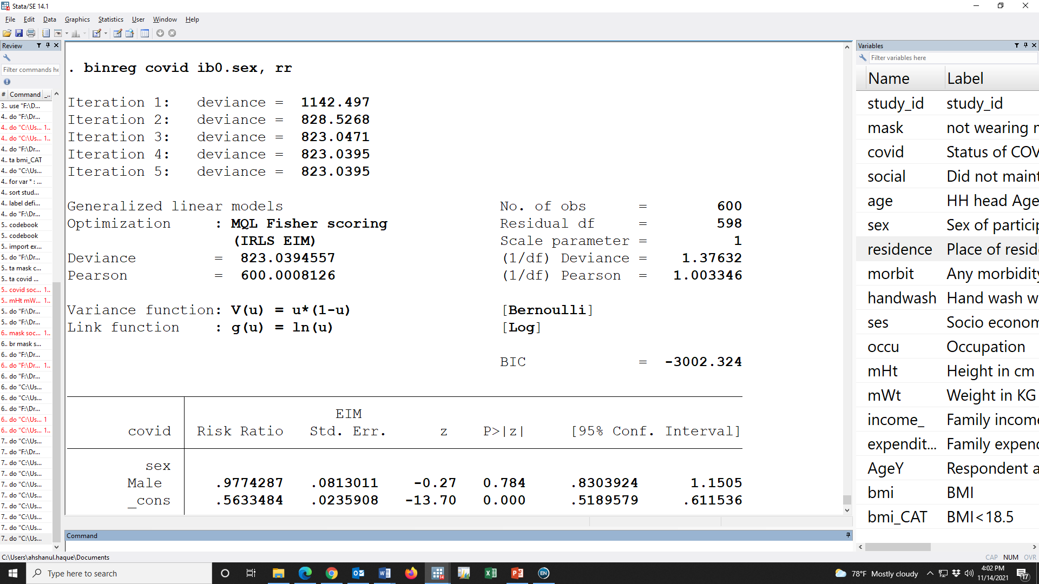
Sex
1 = Male
0 = Female

Slide 84
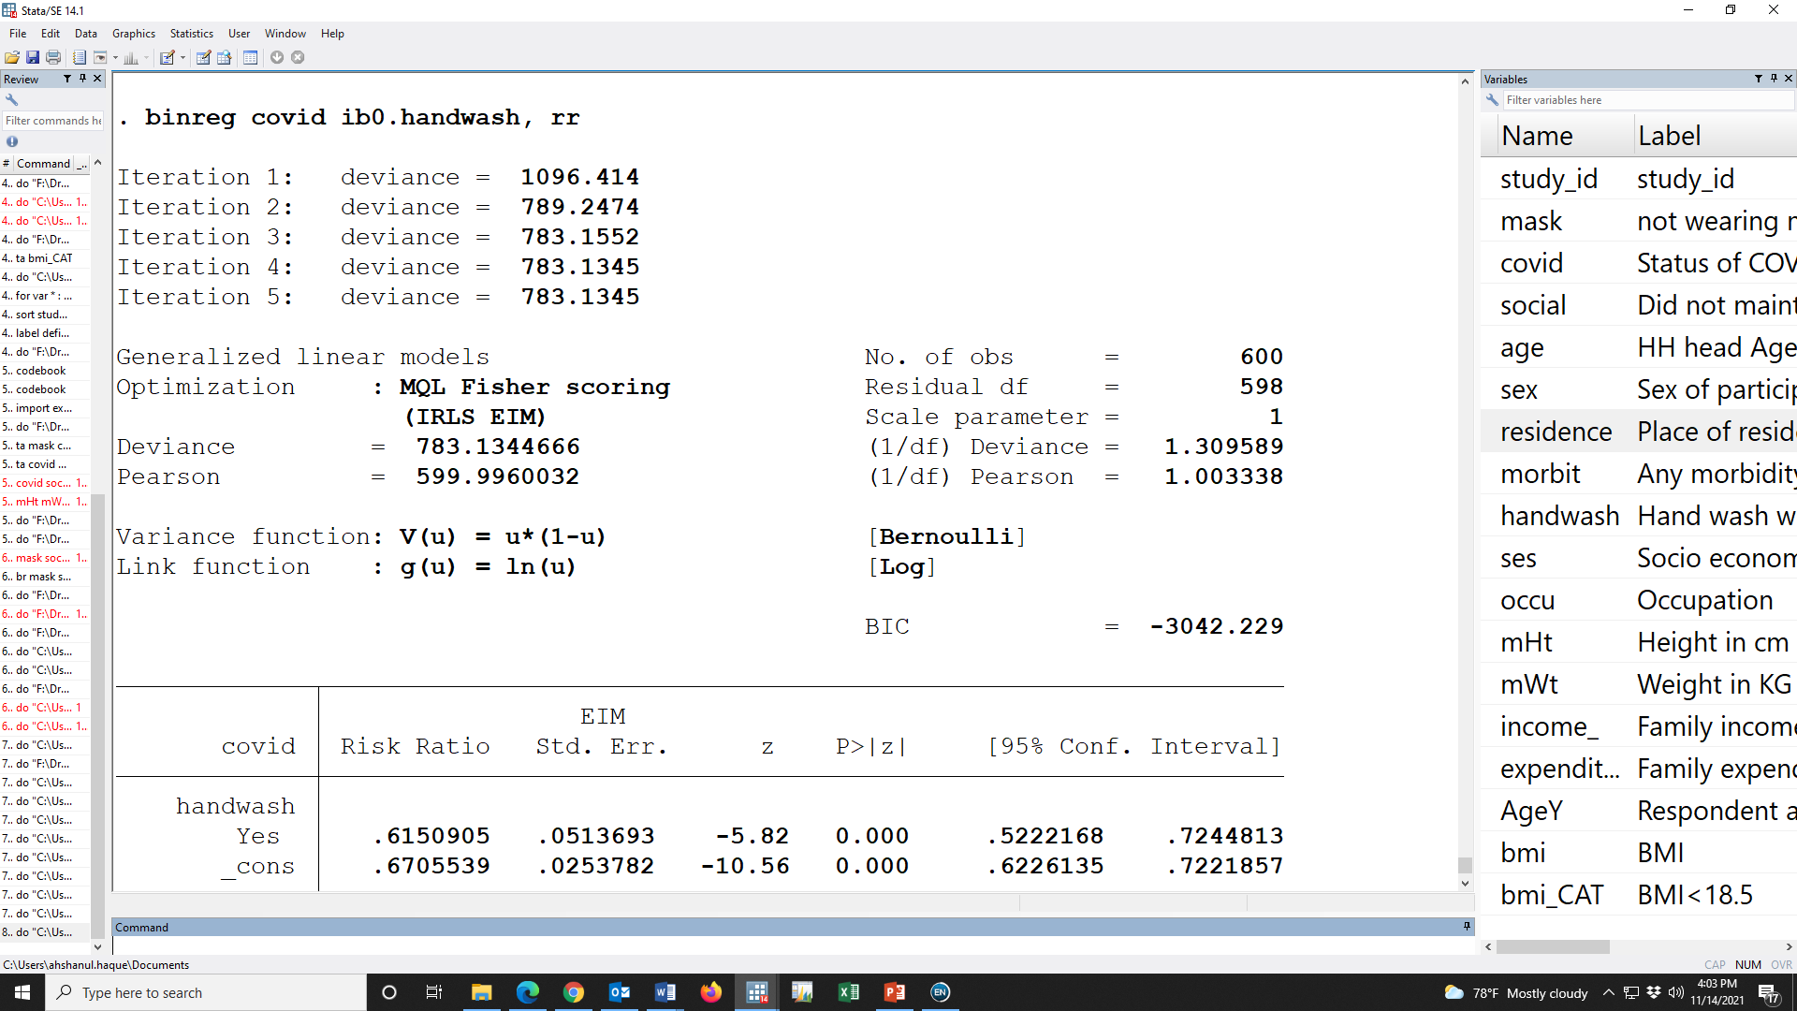
Handwash
0 = No
1 = Yes

Slide 85
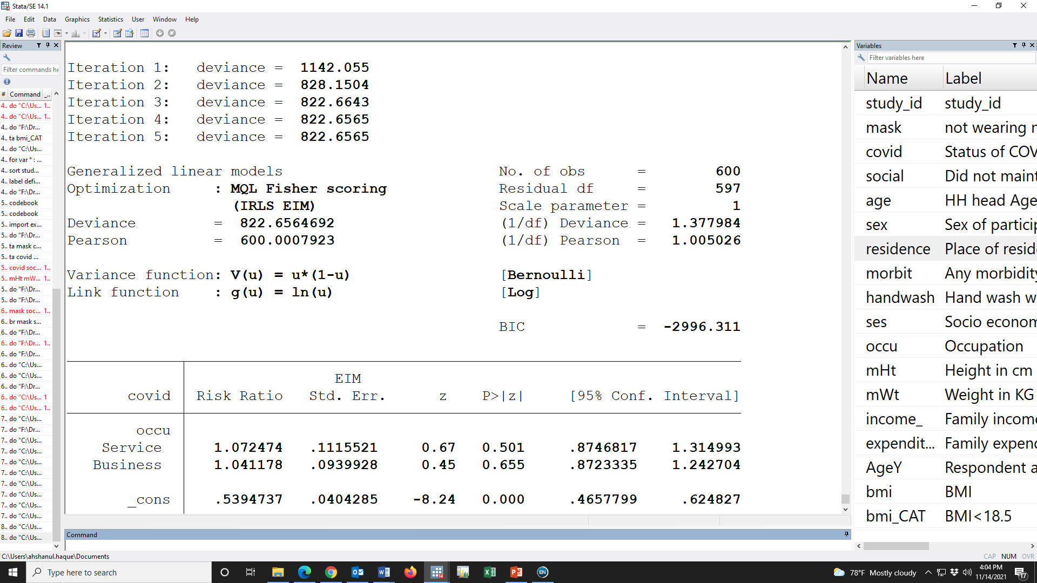
occupation
0 = None
1 = Service
2=Business

Slide 86
 |  | Unadjusted RR (95% CI) | P-value | Adjusted RR (95% CI) | P-value
Wearing mask
 | Yes | Reference |  | Reference
 | No | 1.58 (1.36, 1.84) | 0.000 | 1.43 (1.23, 1.65) | 0.000
Maintained social distance
 | Yes | Reference |  | Reference
 | No | 1.41 (1.22, 1.63) | 0.000 | 1.32 (1.16, 1.51) | 0.000
Age in year
 | <30Y | Reference |  | Reference
 | >=30Y | 1.02 (0.89, 1.18) | 0.762 | 1.06 (0.94, 1.19) | 0.332
Sex of participant
 | Female | Reference |  | Reference
 | Male | 1.02 (0.87, 1.2) | 0.784 | 1.01 (0.88, 1.15) | 0.917
Handwash
 | No | Reference |  | Reference
 | Yes | 0.62 (0.52, 0.72) | 0.000 | 0.67 (0.57, 0.78) | 0.000
Occupation
 | None | Reference |  | Reference
 | Service | 1.07 (0.87, 1.31) | 0.501 | 0.94 (0.79, 1.12) | 0.502
 | Business | 1.04 (0.87, 1.24) | 0.655 | 0.95 (0.81, 1.10) | 0.482

Slide 88
Log linear regression
Having COVID-19 positive ~ Wearing mask
Having COVID-19 positive + Maintained social distance
Having COVID-19 positive + Age in year
Having COVID-19 positive + Sex of participant
Having COVID-19 positive + Handwash
Having COVID-19 positive + Occupation

Slide 89
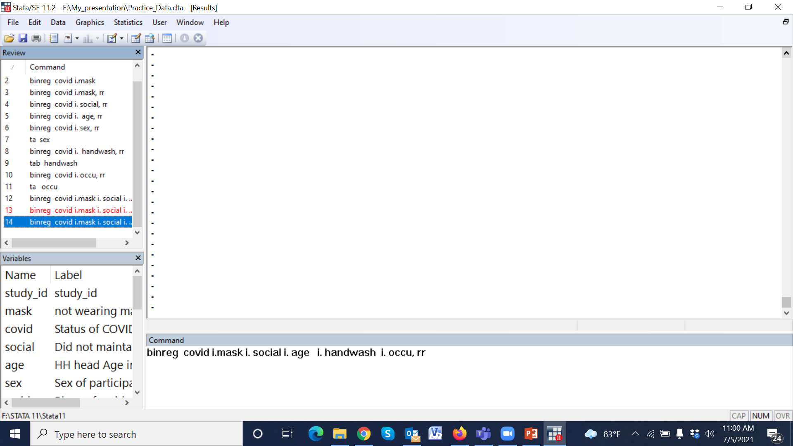
binreg covid ib0.mask ib0.social ib0.age i.handwash ib0.occu, rr

Slide 90
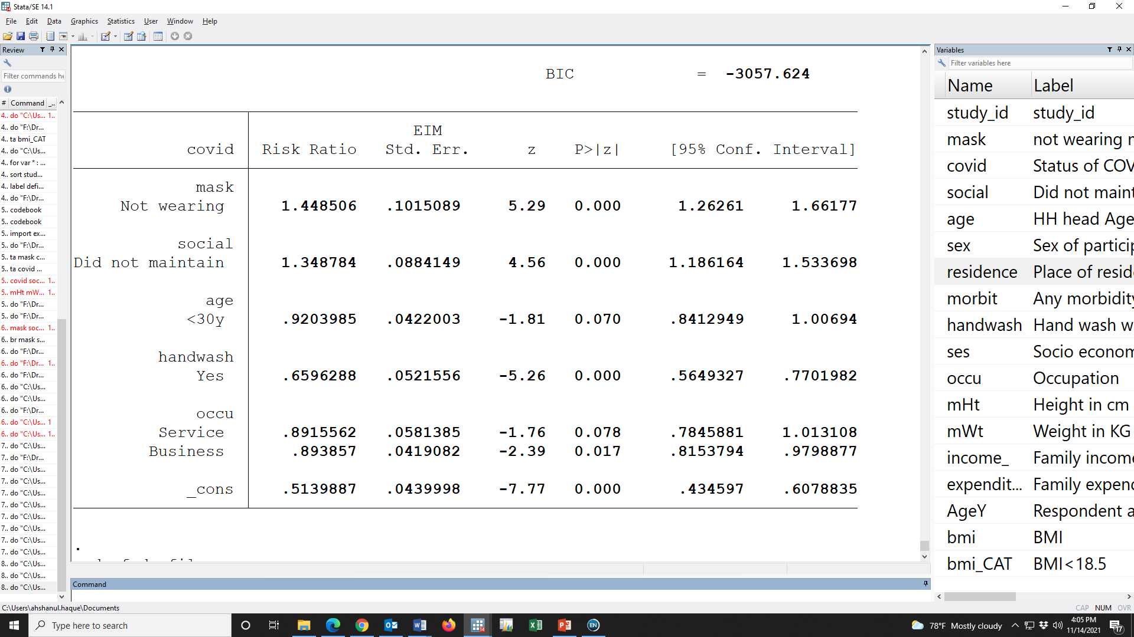

Slide 91
 |  | Unadjusted RR (95% CI) | P-value | Adjusted RR (95% CI) | P-value
Wearing mask
 | Yes | Reference |  | Reference
 | No | 1.58 (1.36, 1.84) | 0.000 | 1.45 (1.26, 1.66) | 0.000
Maintained social distance
 | Yes | Reference |  | Reference
 | No | 1.41 (1.22, 1.63) | 0.000 | 1.35 (1.19, 1.53) | 0.000
Age in year
 | <30Y | Reference |  | Reference
 | >=30Y | 1.02 (0.89, 1.18) | 0.762 | 0.92 (0.84, 1.01) | 0.070
Sex of participant
 | Female | Reference |  | Reference
 | Male | 1.02 (0.87, 1.2) | 0.784 | 1.01 (0.88, 1.15) | 0.917
Handwash
 | No | Reference |  | Reference
 | Yes | 0.62 (0.52, 0.72) | 0.000 | 0.66 (0.57, 0.78) | 0.000
Occupation
 | None | Reference |  | Reference
 | Service | 1.07 (0.87, 1.31) | 0.501 | 0.89 (0.74, 1.01) | 0.078
 | Business | 1.04 (0.87, 1.24) | 0.655 | 0.89 (0.81, 1.10) | 0.017

Slide 92
 |  | Unadjusted RR (95% CI) | P-value | Adjusted RR (95% CI) | P-value
Wearing mask
 | Yes | Reference |  | Reference
 | No | 1.58 (1.36, 1.84) | 0.000 | 1.45 (1.26, 1.66) | 0.000
Maintained social distance
 | Yes | Reference |  | Reference
 | No | 1.41 (1.22, 1.63) | 0.000 | 1.35 (1.19, 1.53) | 0.000
Age in year
 | <30Y | Reference |  | Reference
 | >=30Y | 1.02 (0.89, 1.18) | 0.762 | 0.92 (0.84, 1.01) | 0.070
Sex of participant
 | Female | Reference |  | Reference
 | Male | 1.02 (0.87, 1.2) | 0.784 | 1.01 (0.88, 1.15) | 0.917
Handwash
 | No | Reference |  | Reference
 | Yes | 0.62 (0.52, 0.72) | 0.000 | 0.66 (0.57, 0.78) | 0.000
Occupation
 | None | Reference |  | Reference
 | Service | 1.07 (0.87, 1.31) | 0.501 | 0.89 (0.74, 1.01) | 0.078
 | Business | 1.04 (0.87, 1.24) | 0.655 | 0.89 (0.81, 1.10) | 0.017

Slide 93
 |  | Unadjusted RR (95% CI) | P-value | Adjusted RR (95% CI) | P-value
Wearing mask
 | Yes | Reference |  | Reference
 | No | 1.58 (1.36, 1.84) | 0.000 | 1.45 (1.26, 1.66) | 0.000
Maintained social distance
 | Yes | Reference |  | Reference
 | No | 1.41 (1.22, 1.63) | 0.000 | 1.35 (1.19, 1.53) | 0.000
Age in year
 | <30Y | Reference |  | Reference
 | >=30Y | 1.02 (0.89, 1.18) | 0.762 | 0.92 (0.84, 1.01) | 0.070
Sex of participant
 | Female | Reference |  | Reference
 | Male | 1.02 (0.87, 1.2) | 0.784 | 1.01 (0.88, 1.15) | 0.917
Handwash
 | No | Reference |  | Reference
 | Yes | 0.62 (0.52, 0.72) | 0.000 | 0.66 (0.57, 0.78) | 0.000
Occupation
 | None | Reference |  | Reference
 | Service | 1.07 (0.87, 1.31) | 0.501 | 0.89 (0.74, 1.01) | 0.078
 | Business | 1.04 (0.87, 1.24) | 0.655 | 0.89 (0.81, 1.10) | 0.017
RR>1

Slide 94
 |  | Unadjusted RR (95% CI) | P-value | Adjusted RR (95% CI) | P-value
Wearing mask
 | Yes | Reference |  | Reference
 | No | 1.58 (1.36, 1.84) | 0.000 | 1.45 (1.26, 1.66) | 0.000
Maintained social distance
 | Yes | Reference |  | Reference
 | No | 1.41 (1.22, 1.63) | 0.000 | 1.35 (1.19, 1.53) | 0.000
Age in year
 | <30Y | Reference |  | Reference
 | >=30Y | 1.02 (0.89, 1.18) | 0.762 | 0.92 (0.84, 1.01) | 0.070
Sex of participant
 | Female | Reference |  | Reference
 | Male | 1.02 (0.87, 1.2) | 0.784 | 1.01 (0.88, 1.15) | 0.917
Handwash
 | No | Reference |  | Reference
 | Yes | 0.62 (0.52, 0.72) | 0.000 | 0.66 (0.57, 0.78) | 0.000
Occupation
 | None | Reference |  | Reference
 | Service | 1.07 (0.87, 1.31) | 0.501 | 0.89 (0.74, 1.01) | 0.078
 | Business | 1.04 (0.87, 1.24) | 0.655 | 0.89 (0.81, 1.10) | 0.017
RR>1
indicates greater risk of outcome when exposed than when unexposed

Slide 95
 |  | Unadjusted RR (95% CI) | P-value | Adjusted RR (95% CI) | P-value
Wearing mask
 | Yes | Reference |  | Reference
 | No | 1.58 (1.36, 1.84) | 0.000 | 1.45 (1.26, 1.66) | 0.000
Maintained social distance
 | Yes | Reference |  | Reference
 | No | 1.41 (1.22, 1.63) | 0.000 | 1.35 (1.19, 1.53) | 0.000
Age in year
 | <30Y | Reference |  | Reference
 | >=30Y | 1.02 (0.89, 1.18) | 0.762 | 0.92 (0.84, 1.01) | 0.070
Sex of participant
 | Female | Reference |  | Reference
 | Male | 1.02 (0.87, 1.2) | 0.784 | 1.01 (0.88, 1.15) | 0.917
Handwash
 | No | Reference |  | Reference
 | Yes | 0.62 (0.52, 0.72) | 0.000 | 0.66 (0.57, 0.78) | 0.000
Occupation
 | None | Reference |  | Reference
 | Service | 1.07 (0.87, 1.31) | 0.501 | 0.89 (0.74, 1.01) | 0.078
 | Business | 1.04 (0.87, 1.24) | 0.655 | 0.89 (0.81, 1.10) | 0.017
Risk Ratio= | Risk (who didn’t wear) | =1.43
 | Risk (who wore)

Slide 96
 |  | Unadjusted RR (95% CI) | P-value | Adjusted RR (95% CI) | P-value
Wearing mask
 | Yes | Reference |  | Reference
 | No | 1.58 (1.36, 1.84) | 0.000 | 1.45 (1.26, 1.66) | 0.000
Maintained social distance
 | Yes | Reference |  | Reference
 | No | 1.41 (1.22, 1.63) | 0.000 | 1.35 (1.19, 1.53) | 0.000
Age in year
 | <30Y | Reference |  | Reference
 | >=30Y | 1.02 (0.89, 1.18) | 0.762 | 0.92 (0.84, 1.01) | 0.070
Sex of participant
 | Female | Reference |  | Reference
 | Male | 1.02 (0.87, 1.2) | 0.784 | 1.01 (0.88, 1.15) | 0.917
Handwash
 | No | Reference |  | Reference
 | Yes | 0.62 (0.52, 0.72) | 0.000 | 0.66 (0.57, 0.78) | 0.000
Occupation
 | None | Reference |  | Reference
 | Service | 1.07 (0.87, 1.31) | 0.501 | 0.89 (0.74, 1.01) | 0.078
 | Business | 1.04 (0.87, 1.24) | 0.655 | 0.89 (0.81, 1.10) | 0.017
Risk Ratio= | Risk (who didn’t wear) | =1.45
 | Risk (who wore)

Slide 97
 |  | Unadjusted RR (95% CI) | P-value | Adjusted RR (95% CI) | P-value
Wearing mask
 | Yes | Reference |  | Reference
 | No | 1.58 (1.36, 1.84) | 0.000 | 1.45 (1.26, 1.66) | 0.000
Maintained social distance
 | Yes | Reference |  | Reference
 | No | 1.41 (1.22, 1.63) | 0.000 | 1.35 (1.19, 1.53) | 0.000
Age in year
 | <30Y | Reference |  | Reference
 | >=30Y | 1.02 (0.89, 1.18) | 0.762 | 0.92 (0.84, 1.01) | 0.070
Sex of participant
 | Female | Reference |  | Reference
 | Male | 1.02 (0.87, 1.2) | 0.784 | 1.01 (0.88, 1.15) | 0.917
Handwash
 | No | Reference |  | Reference
 | Yes | 0.62 (0.52, 0.72) | 0.000 | 0.66 (0.57, 0.78) | 0.000
Occupation
 | None | Reference |  | Reference
 | Service | 1.07 (0.87, 1.31) | 0.501 | 0.89 (0.74, 1.01) | 0.078
 | Business | 1.04 (0.87, 1.24) | 0.655 | 0.89 (0.81, 1.10) | 0.017
 | Risk (who didn’t wear) | =1.45
 | Risk (who wore)
=> | Risk (who didn’t wear)=1.45* Risk (who wore)

Slide 98
 |  | Unadjusted RR (95% CI) | P-value | Adjusted RR (95% CI) | P-value
Wearing mask
 | Yes | Reference |  | Reference
 | No | 1.58 (1.36, 1.84) | 0.000 | 1.45 (1.26, 1.66) | 0.000
Maintained social distance
 | Yes | Reference |  | Reference
 | No | 1.41 (1.22, 1.63) | 0.000 | 1.35 (1.19, 1.53) | 0.000
Age in year
 | <30Y | Reference |  | Reference
 | >=30Y | 1.02 (0.89, 1.18) | 0.762 | 0.92 (0.84, 1.01) | 0.070
Sex of participant
 | Female | Reference |  | Reference
 | Male | 1.02 (0.87, 1.2) | 0.784 | 1.01 (0.88, 1.15) | 0.917
Handwash
 | No | Reference |  | Reference
 | Yes | 0.62 (0.52, 0.72) | 0.000 | 0.66 (0.57, 0.78) | 0.000
Occupation
 | None | Reference |  | Reference
 | Service | 1.07 (0.87, 1.31) | 0.501 | 0.89 (0.74, 1.01) | 0.078
 | Business | 1.04 (0.87, 1.24) | 0.655 | 0.89 (0.81, 1.10) | 0.017
 | Risk (who didn’t wear) | =1.45
 | Risk (who wore)
=> | Risk (who didn’t wear)=1.45* Risk (who wore)
Interpretation: The risk of having COVID 19 was 1.45 time among the people who didn’t wear mask than the people who wore

Slide 99
 |  | Unadjusted RR (95% CI) | P-value | Adjusted RR (95% CI) | P-value
Wearing mask
 | Yes | Reference |  | Reference
 | No | 1.58 (1.36, 1.84) | 0.000 | 1.45 (1.26, 1.66) | 0.000
Maintained social distance
 | Yes | Reference |  | Reference
 | No | 1.41 (1.22, 1.63) | 0.000 | 1.35 (1.19, 1.53) | 0.000
Age in year
 | <30Y | Reference |  | Reference
 | >=30Y | 1.02 (0.89, 1.18) | 0.762 | 0.92 (0.84, 1.01) | 0.070
Sex of participant
 | Female | Reference |  | Reference
 | Male | 1.02 (0.87, 1.2) | 0.784 | 1.01 (0.88, 1.15) | 0.917
Handwash
 | No | Reference |  | Reference
 | Yes | 0.62 (0.52, 0.72) | 0.000 | 0.66 (0.57, 0.78) | 0.000
Occupation
 | None | Reference |  | Reference
 | Service | 1.07 (0.87, 1.31) | 0.501 | 0.89 (0.74, 1.01) | 0.078
 | Business | 1.04 (0.87, 1.24) | 0.655 | 0.89 (0.81, 1.10) | 0.017
RR=1

Slide 100
 |  | Unadjusted RR (95% CI) | P-value | Adjusted RR (95% CI) | P-value
Wearing mask
 | Yes | Reference |  | Reference
 | No | 1.58 (1.36, 1.84) | 0.000 | 1.45 (1.26, 1.66) | 0.000
Maintained social distance
 | Yes | Reference |  | Reference
 | No | 1.41 (1.22, 1.63) | 0.000 | 1.35 (1.19, 1.53) | 0.000
Age in year
 | <30Y | Reference |  | Reference
 | >=30Y | 1.02 (0.89, 1.18) | 0.762 | 0.92 (0.84, 1.01) | 0.070
Sex of participant
 | Female | Reference |  | Reference
 | Male | 1.02 (0.87, 1.2) | 0.784 | 1.01 (0.88, 1.15) | 0.917
Handwash
 | No | Reference |  | Reference
 | Yes | 0.62 (0.52, 0.72) | 0.000 | 0.66 (0.57, 0.78) | 0.000
Occupation
 | None | Reference |  | Reference
 | Service | 1.07 (0.87, 1.31) | 0.501 | 0.89 (0.74, 1.01) | 0.078
 | Business | 1.04 (0.87, 1.24) | 0.655 | 0.89 (0.81, 1.10) | 0.017
RR=1
Risk (Female) | =1
Risk (Male)
Or, Risk (Female) = Risk (Male)

Slide 101
 |  | Unadjusted RR (95% CI) | P-value | Adjusted RR (95% CI) | P-value
Wearing mask
 | Yes | Reference |  | Reference
 | No | 1.58 (1.36, 1.84) | 0.000 | 1.45 (1.26, 1.66) | 0.000
Maintained social distance
 | Yes | Reference |  | Reference
 | No | 1.41 (1.22, 1.63) | 0.000 | 1.35 (1.19, 1.53) | 0.000
Age in year
 | <30Y | Reference |  | Reference
 | >=30Y | 1.02 (0.89, 1.18) | 0.762 | 0.92 (0.84, 1.01) | 0.070
Sex of participant
 | Female | Reference |  | Reference
 | Male | 1.02 (0.87, 1.2) | 0.784 | 1.01 (0.88, 1.15) | 0.917
Handwash
 | No | Reference |  | Reference
 | Yes | 0.62 (0.52, 0.72) | 0.000 | 0.66 (0.57, 0.78) | 0.000
Occupation
 | None | Reference |  | Reference
 | Service | 1.07 (0.87, 1.31) | 0.501 | 0.89 (0.74, 1.01) | 0.078
 | Business | 1.04 (0.87, 1.24) | 0.655 | 0.89 (0.81, 1.10) | 0.017
RR < 1 is the lower risk of outcome

Slide 102
 |  | Unadjusted RR (95% CI) | P-value | Adjusted RR (95% CI) | P-value
Wearing mask
 | Yes | Reference |  | Reference
 | No | 1.58 (1.36, 1.84) | 0.000 | 1.45 (1.26, 1.66) | 0.000
Maintained social distance
 | Yes | Reference |  | Reference
 | No | 1.41 (1.22, 1.63) | 0.000 | 1.35 (1.19, 1.53) | 0.000
Age in year
 | <30Y | Reference |  | Reference
 | >=30Y | 1.02 (0.89, 1.18) | 0.762 | 0.92 (0.84, 1.01) | 0.070
Sex of participant
 | Female | Reference |  | Reference
 | Male | 1.02 (0.87, 1.2) | 0.784 | 1.01 (0.88, 1.15) | 0.917
Handwash
 | No | Reference |  | Reference
 | Yes | 0.62 (0.52, 0.72) | 0.000 | 0.66 (0.57, 0.78) | 0.000
Occupation
 | None | Reference |  | Reference
 | Service | 1.07 (0.87, 1.31) | 0.501 | 0.89 (0.74, 1.01) | 0.078
 | Business | 1.04 (0.87, 1.24) | 0.655 | 0.89 (0.81, 1.10) | 0.017
=> | Risk (Handwash, Yes) | = 0.67
 | Risk (Handwash, No)

Slide 103
 |  | Unadjusted RR (95% CI) | P-value | Adjusted RR (95% CI) | P-value
Wearing mask
 | Yes | Reference |  | Reference
 | No | 1.58 (1.36, 1.84) | 0.000 | 1.45 (1.26, 1.66) | 0.000
Maintained social distance
 | Yes | Reference |  | Reference
 | No | 1.41 (1.22, 1.63) | 0.000 | 1.35 (1.19, 1.53) | 0.000
Age in year
 | <30Y | Reference |  | Reference
 | >=30Y | 1.02 (0.89, 1.18) | 0.762 | 0.92 (0.84, 1.01) | 0.070
Sex of participant
 | Female | Reference |  | Reference
 | Male | 1.02 (0.87, 1.2) | 0.784 | 1.01 (0.88, 1.15) | 0.917
Handwash
 | No | Reference |  | Reference
 | Yes | 0.62 (0.52, 0.72) | 0.000 | 0.66 (0.57, 0.78) | 0.000
Occupation
 | None | Reference |  | Reference
 | Service | 1.07 (0.87, 1.31) | 0.501 | 0.89 (0.74, 1.01) | 0.078
 | Business | 1.04 (0.87, 1.24) | 0.655 | 0.89 (0.81, 1.10) | 0.017
=> | Risk (Handwash, Yes) | = 0.67
 | Risk (Handwash, No)
=> | Risk (Handwash, Yes) | = | 1
 | Risk (Handwash, No) |  | 1.49

Slide 104
 |  | Unadjusted RR (95% CI) | P-value | Adjusted RR (95% CI) | P-value
Wearing mask
 | Yes | Reference |  | Reference
 | No | 1.58 (1.36, 1.84) | 0.000 | 1.45 (1.26, 1.66) | 0.000
Maintained social distance
 | Yes | Reference |  | Reference
 | No | 1.41 (1.22, 1.63) | 0.000 | 1.35 (1.19, 1.53) | 0.000
Age in year
 | <30Y | Reference |  | Reference
 | >=30Y | 1.02 (0.89, 1.18) | 0.762 | 0.92 (0.84, 1.01) | 0.070
Sex of participant
 | Female | Reference |  | Reference
 | Male | 1.02 (0.87, 1.2) | 0.784 | 1.01 (0.88, 1.15) | 0.917
Handwash
 | No | Reference |  | Reference
 | Yes | 0.62 (0.52, 0.72) | 0.000 | 0.66 (0.57, 0.78) | 0.000
Occupation
 | None | Reference |  | Reference
 | Service | 1.07 (0.87, 1.31) | 0.501 | 0.89 (0.74, 1.01) | 0.078
 | Business | 1.04 (0.87, 1.24) | 0.655 | 0.89 (0.81, 1.10) | 0.017
=> | Risk (Handwash, Yes) | = 0.67
 | Risk (Handwash, No)
=> | Risk (Handwash, Yes) | = | 1
 | Risk (Handwash, No) |  | 1.49
=> | 1.49 x Risk (Handwash, Yes) | = | Risk (Handwash, No)

Slide 105
 |  | Unadjusted RR (95% CI) | P-value | Adjusted RR (95% CI) | P-value
Wearing mask
 | Yes | Reference |  | Reference
 | No | 1.58 (1.36, 1.84) | 0.000 | 1.43 (1.23, 1.65) | 0.000
Maintained social distance
 | Yes | Reference |  | Reference
 | No | 1.41 (1.22, 1.63) | 0.000 | 1.32 (1.16, 1.51) | 0.000
Age in year
 | <30Y | Reference |  | Reference
 | >=30Y | 1.02 (0.89, 1.18) | 0.762 | 1.06 (0.94, 1.19) | 0.332
Sex of participant
 | Female | Reference |  | Reference
 | Male | 1.02 (0.87, 1.2) | 0.784 | 1.01 (0.88, 1.15) | 0.917
Handwash
 | No | Reference |  | Reference
 | Yes | 0.62 (0.52, 0.72) | 0.000 | 0.67 (0.57, 0.78) | 0.000
Occupation
 | None | Reference |  | Reference
 | Service | 1.07 (0.87, 1.31) | 0.501 | 0.94 (0.79, 1.12) | 0.502
 | Business | 1.04 (0.87, 1.24) | 0.655 | 0.95 (0.81, 1.10) | 0.482
=> | Risk (Handwash, Yes) | = 0.67
 | Risk (Handwash, No)
=> | Risk (Handwash, Yes) | = | 1
 | Risk (Handwash, No) |  | 1.49
=> | 1.49 x Risk (Handwash, Yes) | = | Risk (Handwash, No)
The risk of having COVID-19 was 49% lower among the people who wash their hand than the people who do not wash

Slide 106
 |  | Unadjusted RR (95% CI) | P-value | Adjusted RR (95% CI) | P-value
Wearing mask
 | Yes | Reference |  | Reference
 | No | 1.58 (1.36, 1.84) | 0.000 | 1.43 (1.23, 1.65) | 0.000
Maintained social distance
 | Yes | Reference |  | Reference
 | No | 1.41 (1.22, 1.63) | 0.000 | 1.32 (1.16, 1.51) | 0.000
Age in year
 | <30Y | Reference |  | Reference
 | >=30Y | 1.02 (0.89, 1.18) | 0.762 | 1.06 (0.94, 1.19) | 0.332
Sex of participant
 | Female | Reference |  | Reference
 | Male | 1.02 (0.87, 1.2) | 0.784 | 1.01 (0.88, 1.15) | 0.917
Handwash
 | No | Reference |  | Reference
 | Yes | 0.62 (0.52, 0.72) | 0.000 | 0.67 (0.57, 0.78) | 0.000
Occupation
 | None | Reference |  | Reference
 | Service | 1.07 (0.87, 1.31) | 0.501 | 0.94 (0.79, 1.12) | 0.502
 | Business | 1.04 (0.87, 1.24) | 0.655 | 0.95 (0.81, 1.10) | 0.482
=> | Risk (Handwash, Yes) | = 0.67
 | Risk (Handwash, No)
=> | Risk (Handwash, Yes) | = | 1
 | Risk (Handwash, No) |  | 1.49
=> | 1.49 x Risk (Handwash, Yes) | = | Risk (Handwash, No)
The risk of having COVID-19 was 1.49 times less likely among the people who wash their hand than the people who do not wash

Slide 107
 |  | Unadjusted RR (95% CI) | P-value | Adjusted RR (95% CI) | P-value
Wearing mask
 | Yes | Reference |  | Reference
 | No | 1.58 (1.36, 1.84) | 0.000 | 1.45 (1.26, 1.66) | 0.000
Maintained social distance
 | Yes | Reference |  | Reference
 | No | 1.41 (1.22, 1.63) | 0.000 | 1.35 (1.19, 1.53) | 0.000
Age in year
 | <30Y | Reference |  | Reference
 | >=30Y | 1.02 (0.89, 1.18) | 0.762 | 0.92 (0.84, 1.01) | 0.070
Sex of participant
 | Female | Reference |  | Reference
 | Male | 1.02 (0.87, 1.2) | 0.784 | 1.01 (0.88, 1.15) | 0.917
Handwash
 | No | Reference |  | Reference
 | Yes | 0.62 (0.52, 0.72) | 0.000 | 0.66 (0.57, 0.78) | 0.000
Occupation
 | None | Reference |  | Reference
 | Service | 1.07 (0.87, 1.31) | 0.501 | 0.89 (0.74, 1.01) | 0.078
 | Business | 1.04 (0.87, 1.24) | 0.655 | 0.89 (0.81, 1.10) | 0.017

Slide 108
 |  | Unadjusted RR (95% CI) | P-value | Adjusted RR (95% CI) | P-value
Wearing mask
 | Yes | Reference |  | Reference
 | No | 1.58 (1.36, 1.84) | 0.000 | 1.45 (1.26, 1.66) | 0.000
Maintained social distance
 | Yes | Reference |  | Reference
 | No | 1.41 (1.22, 1.63) | 0.000 | 1.35 (1.19, 1.53) | 0.000
Age in year
 | <30Y | Reference |  | Reference
 | >=30Y | 1.02 (0.89, 1.18) | 0.762 | 0.92 (0.84, 1.01) | 0.070
Sex of participant
 | Female | Reference |  | Reference
 | Male | 1.02 (0.87, 1.2) | 0.784 | 1.01 (0.88, 1.15) | 0.917
Handwash
 | No | Reference |  | Reference
 | Yes | 0.62 (0.52, 0.72) | 0.000 | 0.66 (0.57, 0.78) | 0.000
Occupation
 | None | Reference |  | Reference
 | Service | 1.07 (0.87, 1.31) | 0.501 | 0.89 (0.74, 1.01) | 0.078
 | Business | 1.04 (0.87, 1.24) | 0.655 | 0.89 (0.81, 1.10) | 0.017
Data Analysis Plan
Explorative statistics: To test the hypothesis of interest that not wearing mask is a one of the most important risk factor of having COVID-19 positive, a simple log linear regression was assessed computing the bi-variate associations (Risk Ratio) between outcome variable and the exposure variables. To estimate adjusted Risk Ratio of the not wearing mask as an exposure, generalized linear with log binomial regression model was computed after adjusting for relevant co-variates.

Slide 109
 |  | Unadjusted RR (95% CI) | P-value | Adjusted RR (95% CI) | P-value
Wearing mask
 | Yes | Reference |  | Reference
 | No | 1.58 (1.36, 1.84) | 0.000 | 1.45 (1.26, 1.66) | 0.000
Maintained social distance
 | Yes | Reference |  | Reference
 | No | 1.41 (1.22, 1.63) | 0.000 | 1.35 (1.19, 1.53) | 0.000
Age in year
 | <30Y | Reference |  | Reference
 | >=30Y | 1.02 (0.89, 1.18) | 0.762 | 0.92 (0.84, 1.01) | 0.070
Sex of participant
 | Female | Reference |  | Reference
 | Male | 1.02 (0.87, 1.2) | 0.784 | 1.01 (0.88, 1.15) | 0.917
Handwash
 | No | Reference |  | Reference
 | Yes | 0.62 (0.52, 0.72) | 0.000 | 0.66 (0.57, 0.78) | 0.000
Occupation
 | None | Reference |  | Reference
 | Service | 1.07 (0.87, 1.31) | 0.501 | 0.89 (0.74, 1.01) | 0.078
 | Business | 1.04 (0.87, 1.24) | 0.655 | 0.89 (0.81, 1.10) | 0.017
Results: The adjusted and unadjusted Risk Ratios were estimated to examine the strength of the associations computed from log linear regression which are shown in Table ##. The risk of having COVID-19 was 1.45 [RR: 1.45 (95% CI: 1.26, 1.66); p-value< 0.001] time among the people who didn’t wear mask than the people who wore which indicates that not wearing mask was significantly associated with having COVID-19 positive. Moreover, did not maintain social distance [RR: 1.32 (95% CI: 1.16, 1.51); p-value<0.001] and handwashing practice [RR: 0.67 (95% CI: 0.57, 0.78); p-value<0.001] were also associated with having COVID-19 positive.

Slide 110
 |  | Unadjusted RR (95% CI) | P-value | Adjusted RR (95% CI) | P-value
Wearing mask
 | Yes | Reference |  | Reference
 | No | 1.58 (1.36, 1.84) | 0.000 | 1.45 (1.26, 1.66) | 0.000
Maintained social distance
 | Yes | Reference |  | Reference
 | No | 1.41 (1.22, 1.63) | 0.000 | 1.35 (1.19, 1.53) | 0.000
Age in year
 | <30Y | Reference |  | Reference
 | >=30Y | 1.02 (0.89, 1.18) | 0.762 | 0.92 (0.84, 1.01) | 0.070
Sex of participant
 | Female | Reference |  | Reference
 | Male | 1.02 (0.87, 1.2) | 0.784 | 1.01 (0.88, 1.15) | 0.917
Handwash
 | No | Reference |  | Reference
 | Yes | 0.62 (0.52, 0.72) | 0.000 | 0.66 (0.57, 0.78) | 0.000
Occupation
 | None | Reference |  | Reference
 | Service | 1.07 (0.87, 1.31) | 0.501 | 0.89 (0.74, 1.01) | 0.078
 | Business | 1.04 (0.87, 1.24) | 0.655 | 0.89 (0.81, 1.10) | 0.017
Results: The adjusted and unadjusted Risk Ratios were estimated to examine the strength of the associations computed from log linear regression which are shown in Table ##. The risk of having COVID-19 was 1.45 [RR: 1.45 (95% CI: 1.26, 1.66); p-value< 0.001] time among the people who didn’t wear mask than the people who wore which indicates that not wearing mask was significantly associated with having COVID-19 positive. Moreover, did not maintain social distance [RR: 1.32 (95% CI: 1.16, 1.51); p-value<0.001] and handwashing practice [RR: 0.67 (95% CI: 0.57, 0.78); p-value<0.001] were also associated with having COVID-19 positive.
After adjusting the relevant covariates

Slide 112
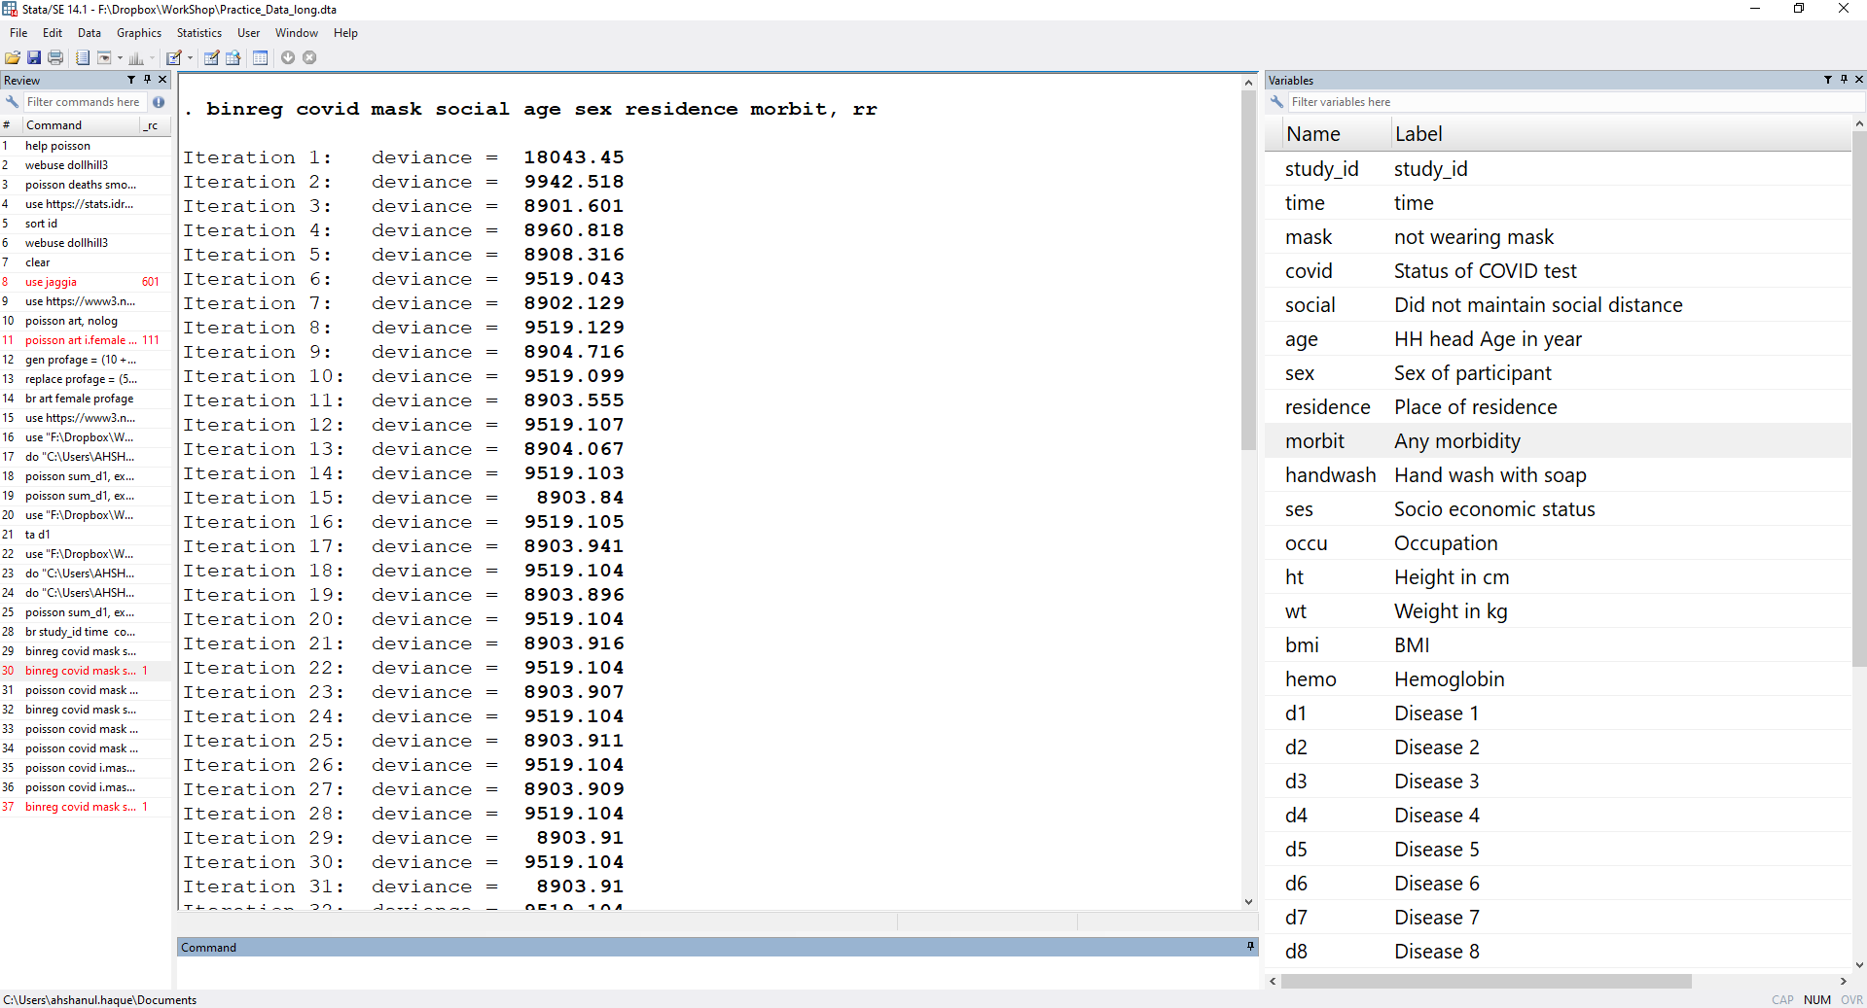
binreg covid ib0.mask ib0.edu ib0.ses ib0.social ib0.age i.handwash ib1.sex ib0.occu, rr

Slide 113
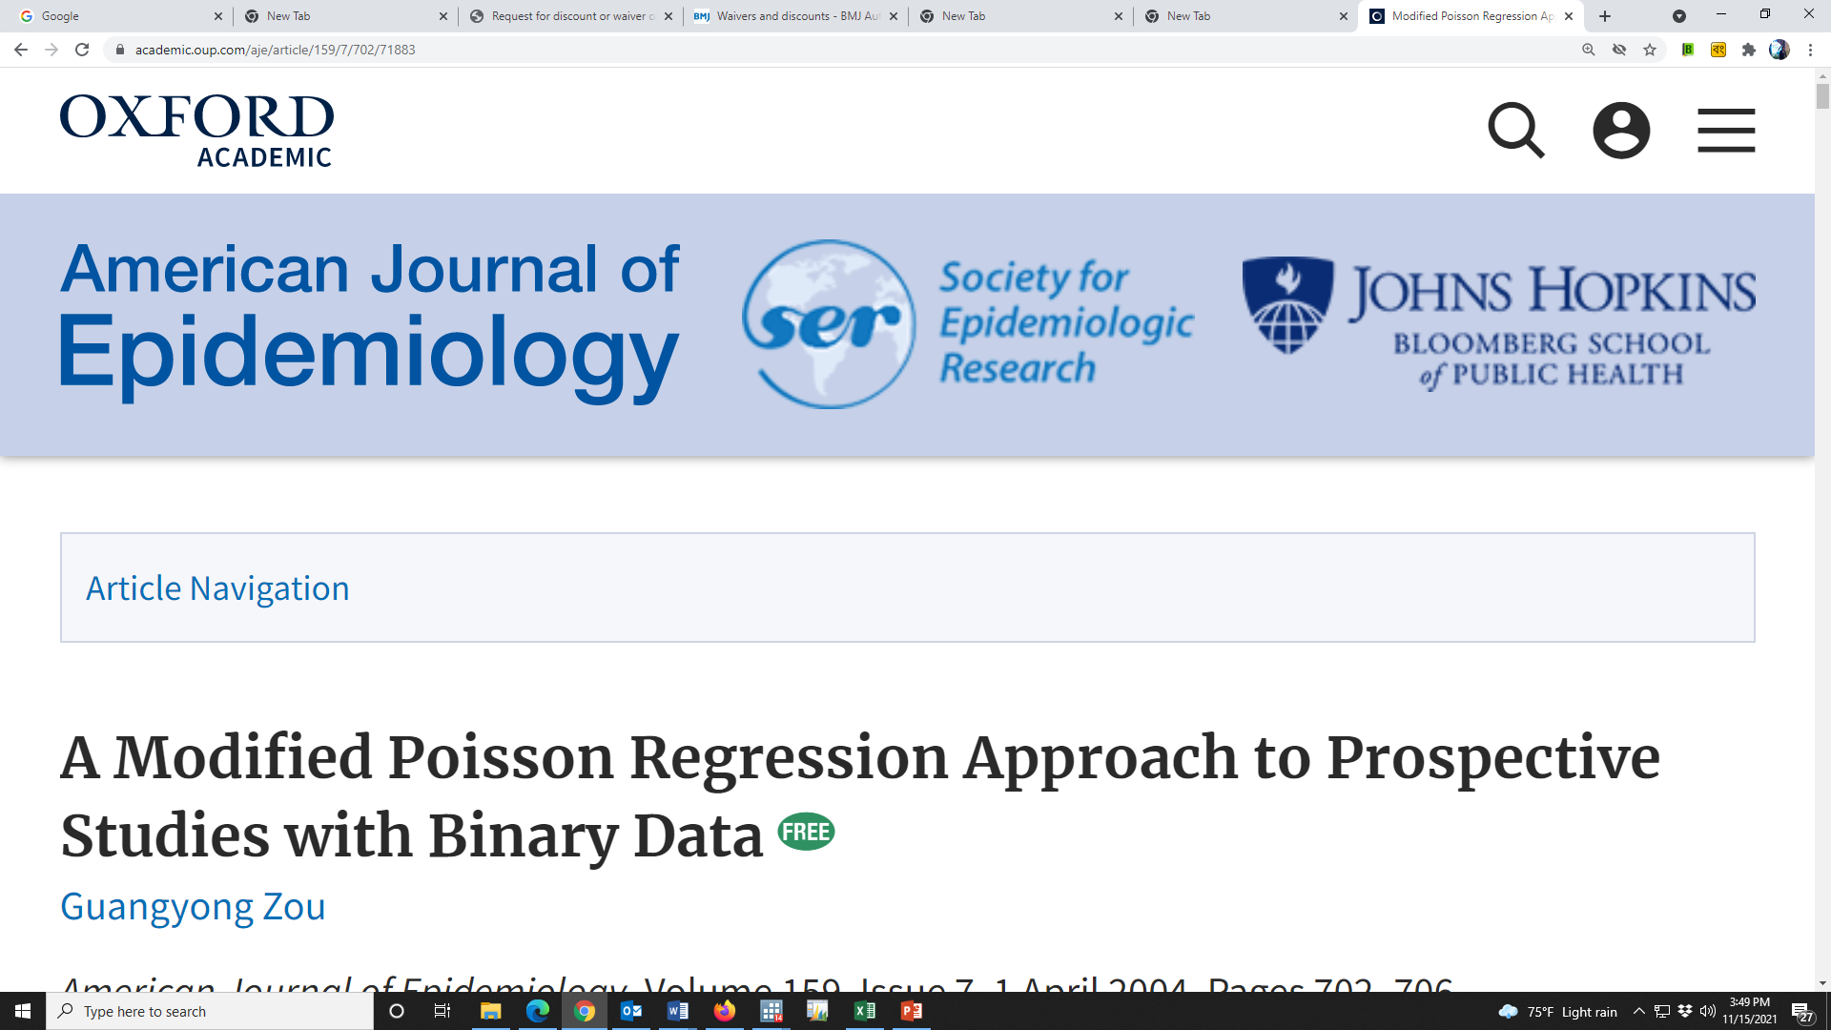

Slide 114
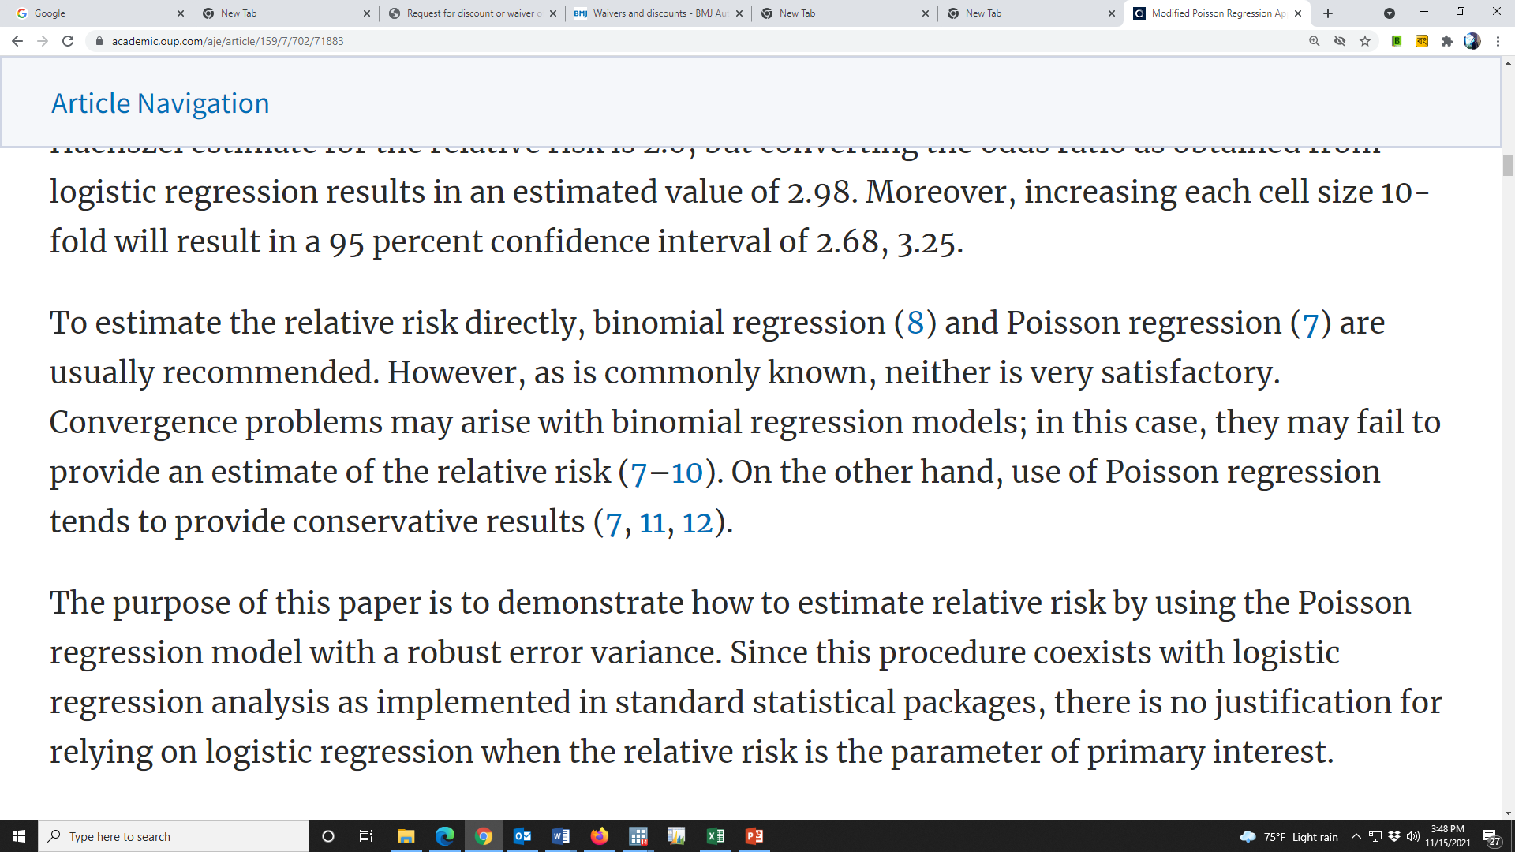

Slide 115
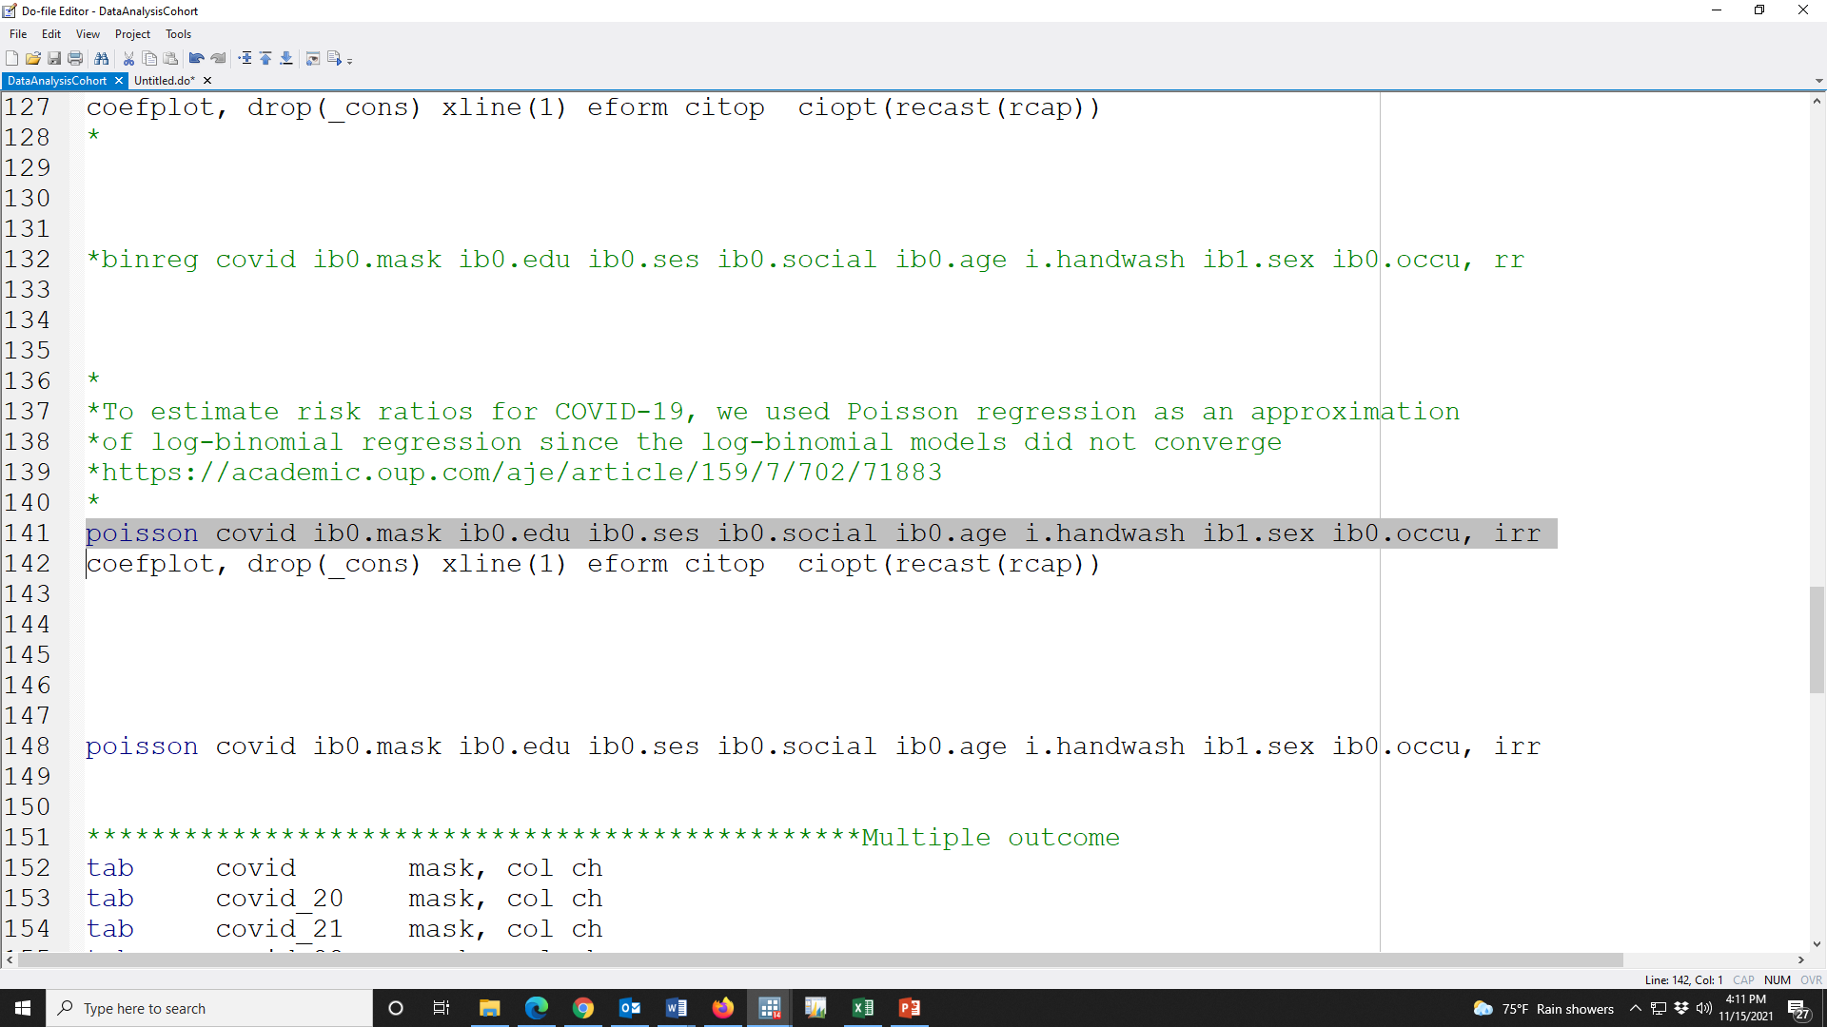

Slide 116
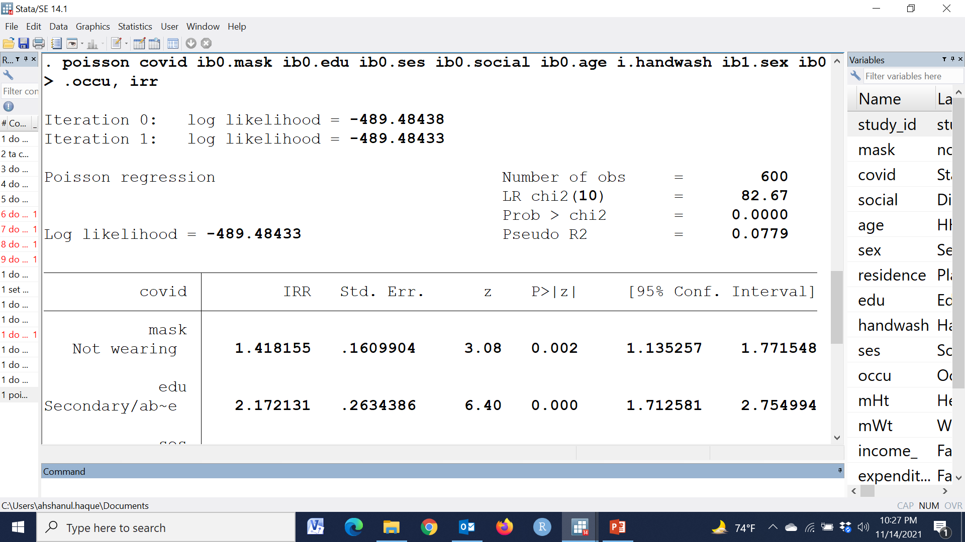

Slide 117
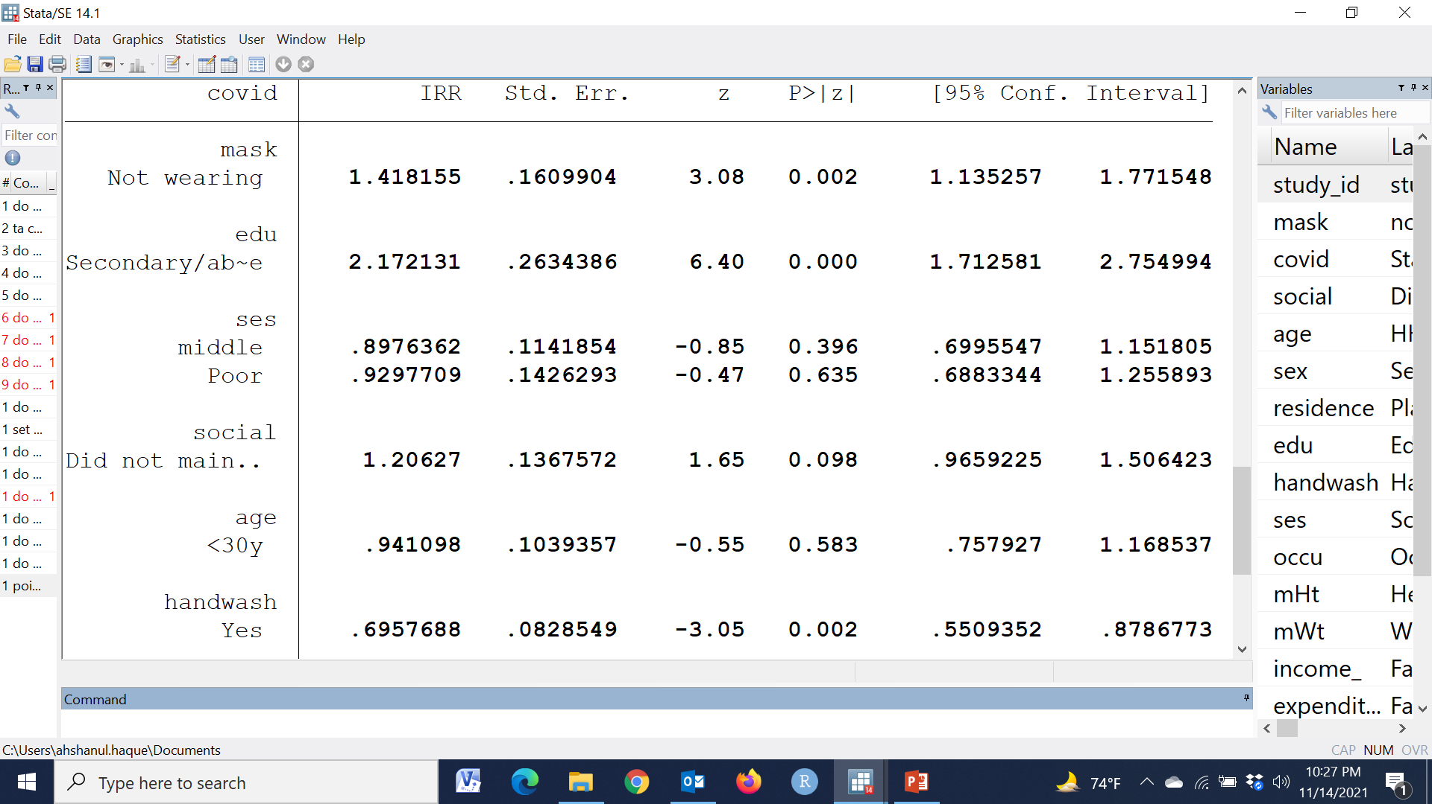

Slide 118
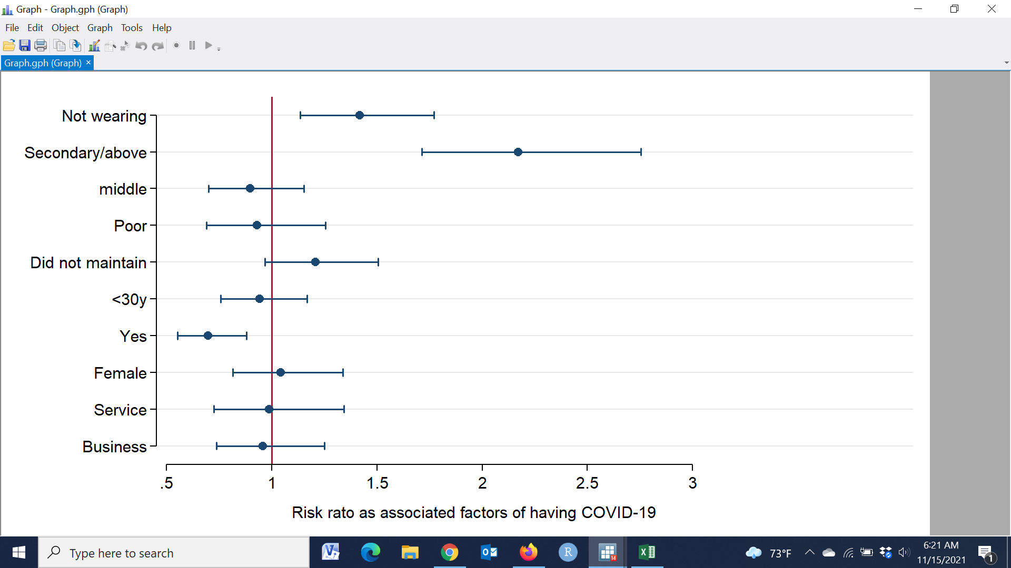

Slide 119
Results: After adjusting the relevant covariates, the risk of having COVID-19 was 1.42 [RR: 1.42 (95% CI: 1.14, 1.77); p-value< 0.002] time among the people who didn’t wear mask than the people who wore which indicates that not wearing mask was significantly associated with having COVID-19 positive.

Slide 120
Data Analysis Plan
Explorative statistics: To test the hypothesis of interest that not wearing mask is a one of the most important risk factor of having COVID-19 positive, a simple log linear regression was assessed computing the bi-variate associations (Risk Ratio) between outcome variable and the exposure variables. To estimate adjusted Risk Ratio of the not wearing mask as an exposure, generalized linear with log binomial regression model was computed after adjusting for relevant co-variates.
-----we used Poisson regression as an approximation of log-binomial regression since the log-binomial models did not converge----

Slide 121
Another objective
Assess the association of not wearing mask with several COVID status such as covid-19, covid-20, covid-21, covid-22, covid-23, covid-24, covid-25, and covid-26

Slide 122
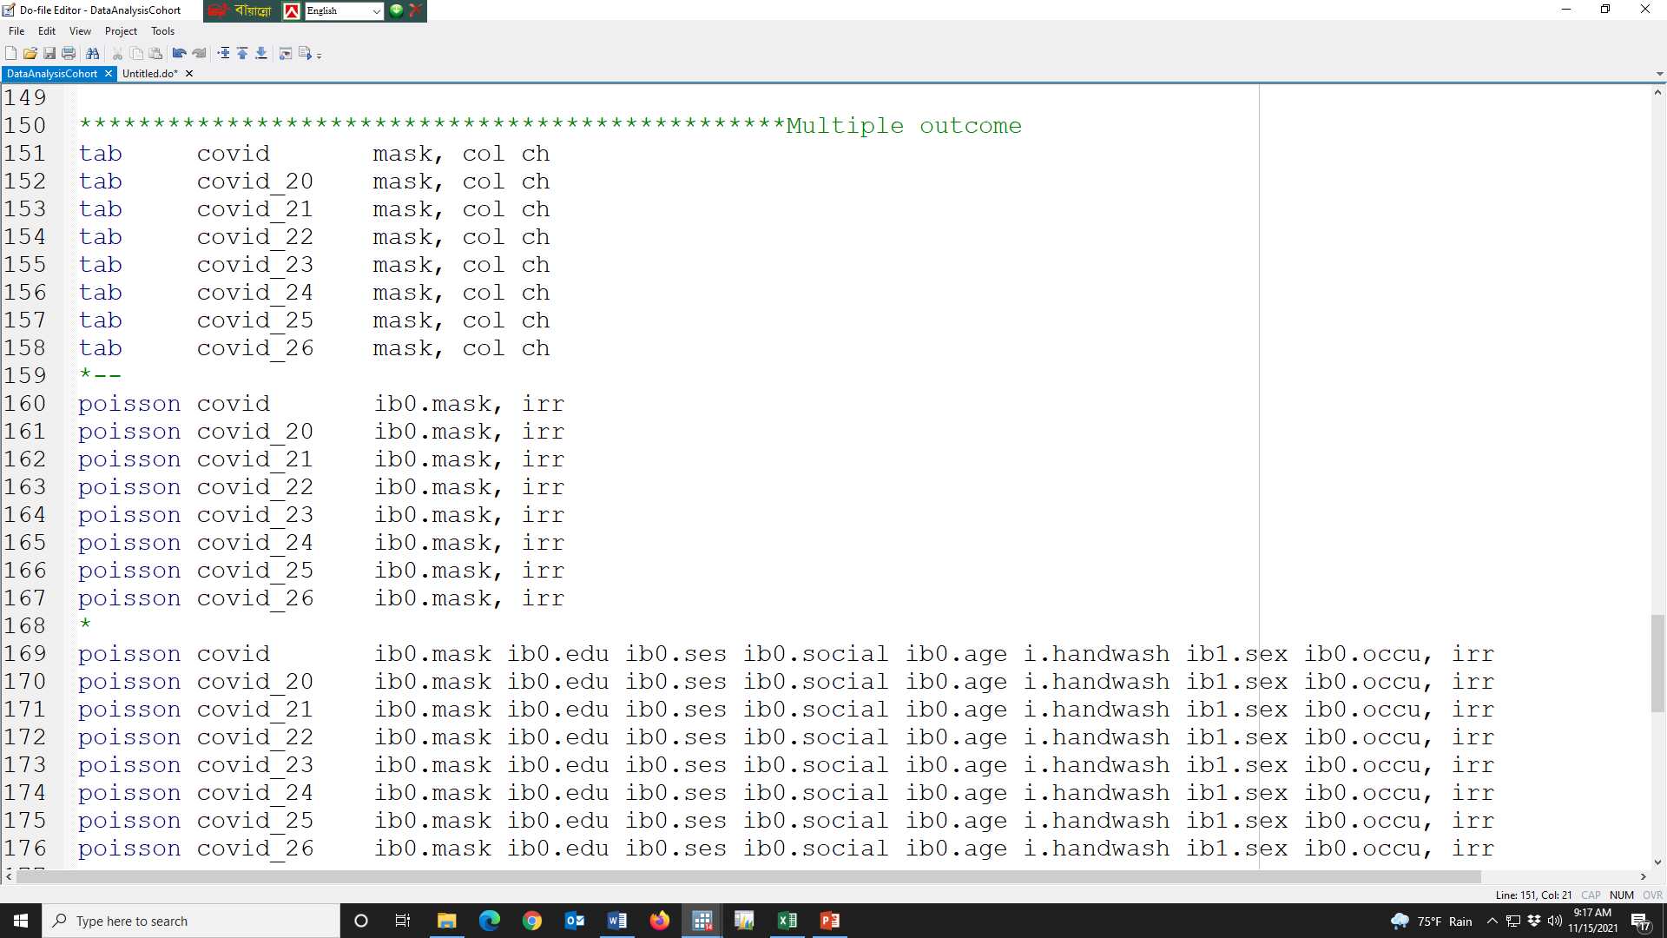

Slide 123
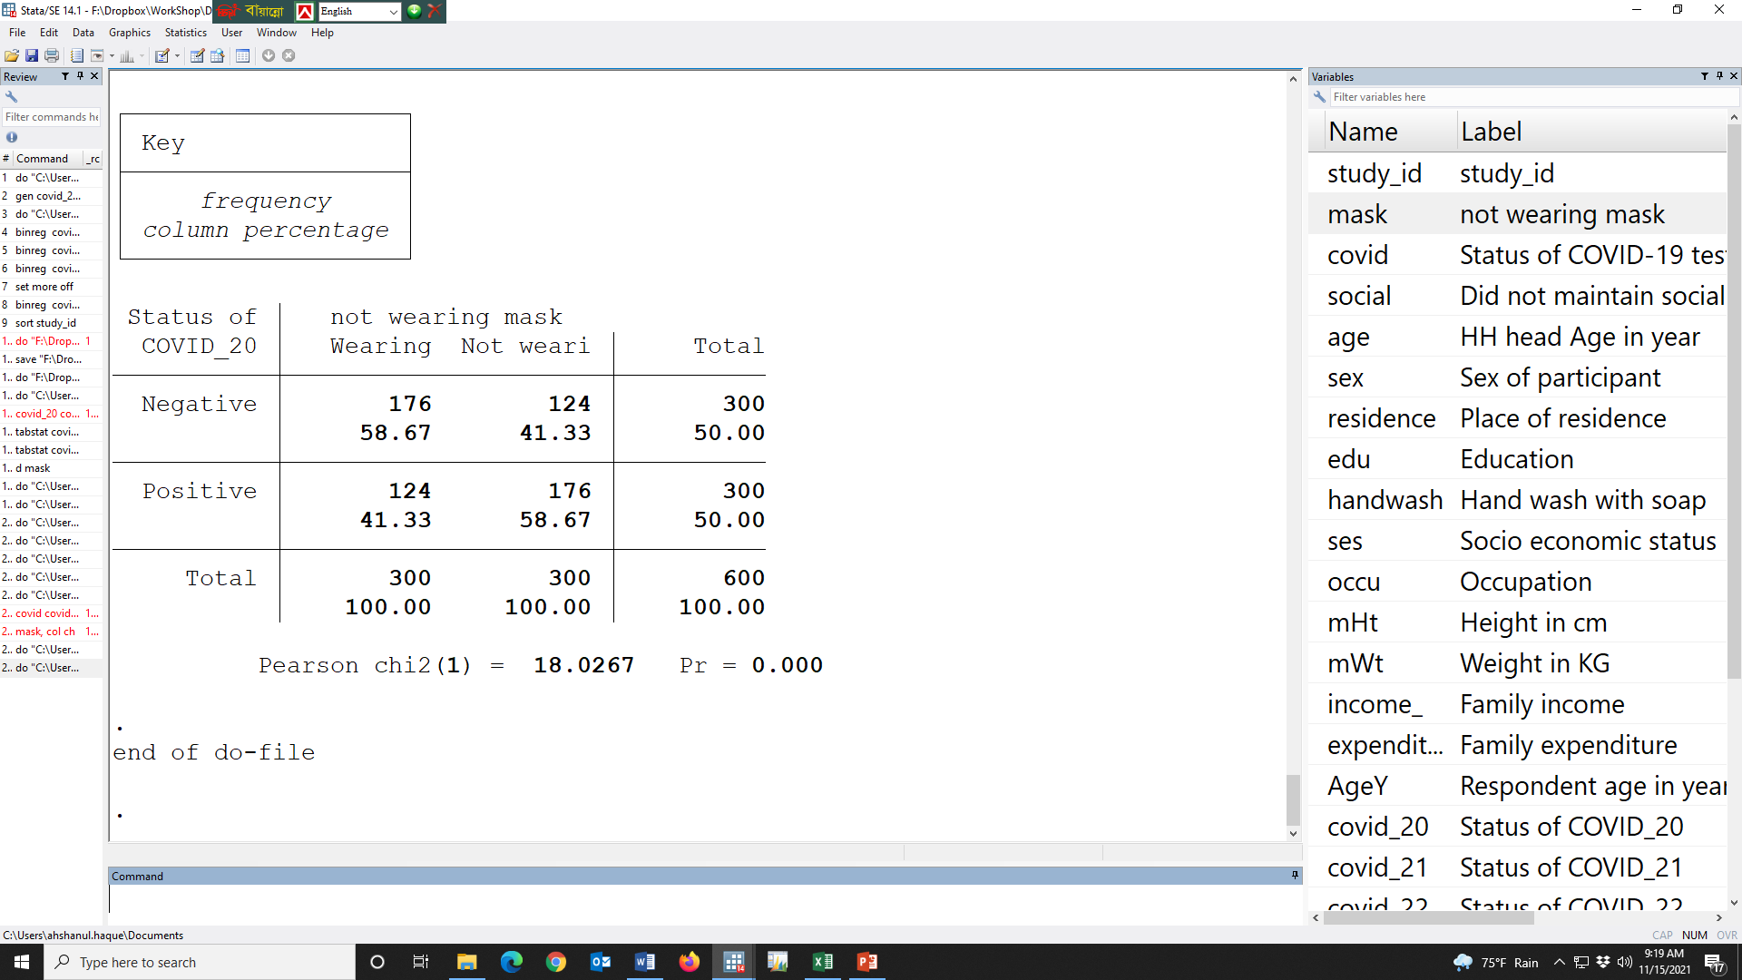

Slide 124
Table ##. Incidence of having several types of COVID status by wearing mask or not
Several types of COVID status | Wearing mask, n (%)
 | No | Yes | Overall
COVID-19 | 206 (68.67) | 130 (43.33) | 336 (56.00)
COVID-20 | 176 (58.67) | 124 (41.33) | 300 (50.00)
COVID-21 | 182 (60.67) | 129 (43.00) | 311 (51.83)
COVID-22 | 176 (58.67) | 136 (45.33) | 312 (52.00)
COVID-23 | 175 (58.33) | 129 (43.00) | 304 (50.67)
COVID-24 | 162 (54.00) | 116 (38.67) | 278 (46.33)
COVID-25 | 168 (56.00) | 128 (42.67) | 296 (49.33)
COVID-26 | 171 (57.00) | 124 (41.33) | 295 (49.17)

Slide 126
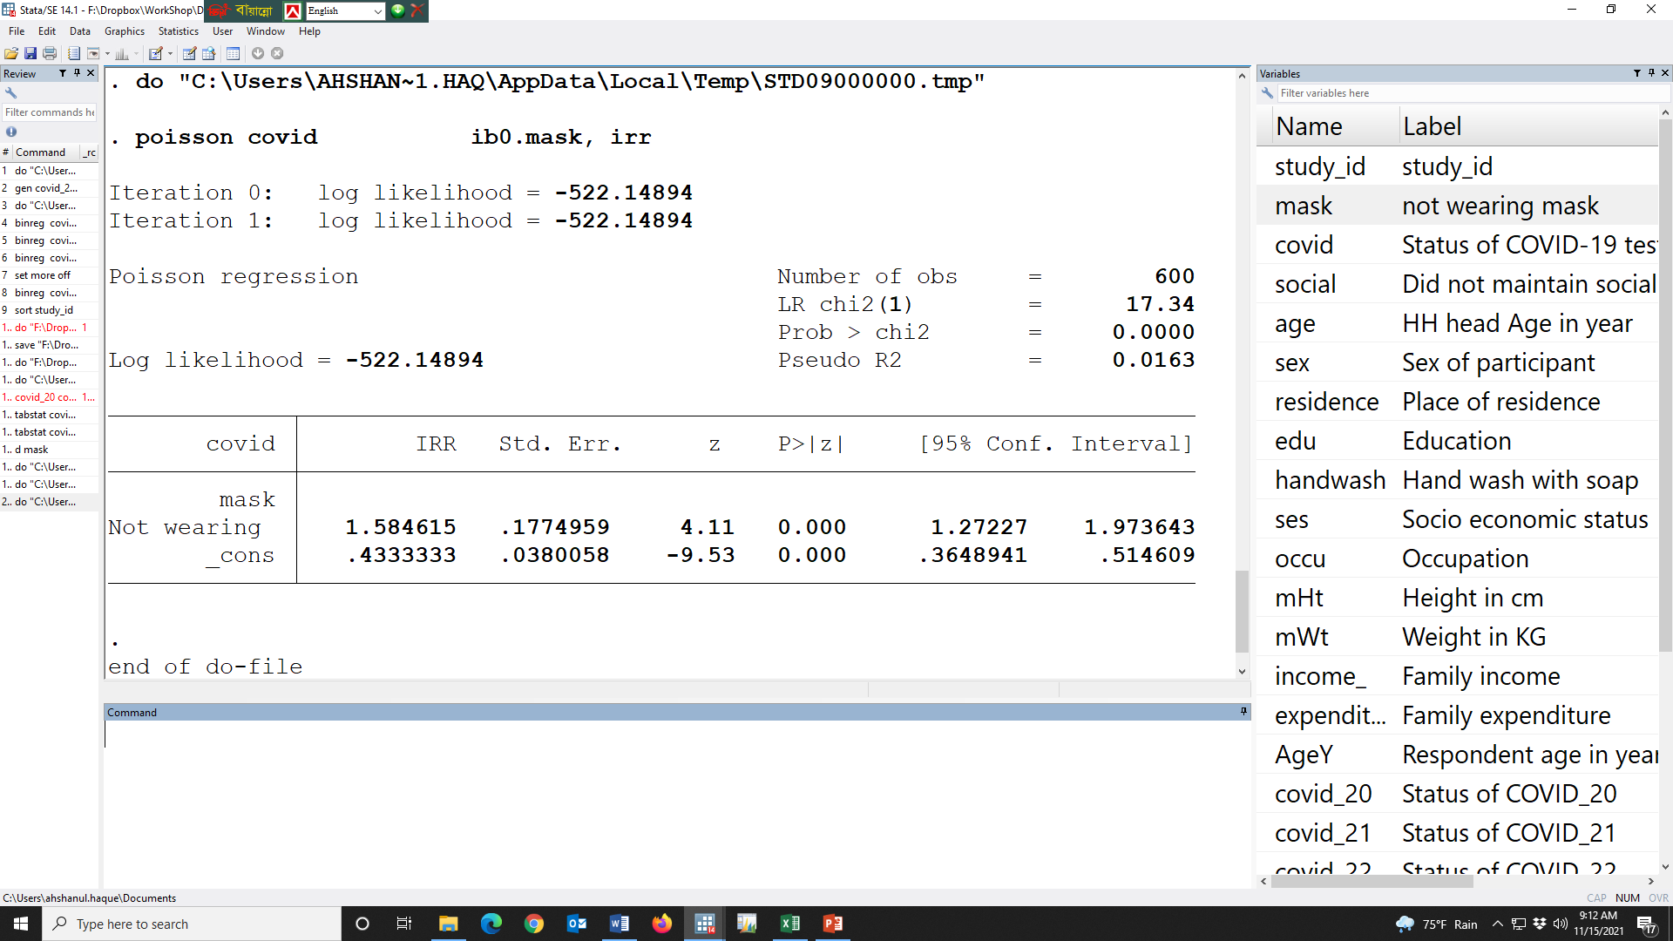

Slide 127
Table ##Risk ratio as the strength of association between several types of COVID status and not wearing mask compare to the people who wore
Several types of COVID status | Unadjusted¹ RR (95% CI) | p-value | Adjusted RR² (95% CI) | p-value
Covid-19 | 1.58 (1.27, 1.97) | 0.000 | 1.42 (1.14, 1.77) | 0.002
Covid-20 | 1.42 (1.13, 1.79) | 0.003 | 1.33 (1.05, 1.67) | 0.018
Covid-21 | 1.41 (1.13, 1.77) | 0.003 | 1.30 (1.03, 1.63) | 0.026
Covid-22 | 1.29 (1.03, 1.62) | 0.024 | 1.19 (0.95, 1.49) | 0.140
Covid-23 | 1.36 (1.08, 1.70) | 0.009 | 1.25 (0.99, 1.57) | 0.058
Covid-24 | 1.40 (1.10, 1.77) | 0.006 | 1.28 (1.00, 1.63) | 0.048
Covid-25 | 1.31 (1.04, 1.65) | 0.020 | 1.19 (0.94, 1.50) | 0.151
Covid-26 | 1.38 (1.09, 1.74) | 0.006 | 1.25 (0.99, 1.59) | 0.058
¹Risk ratios were calculated using simple Poisson regression model for each outcome where several types of COVID status’s were the outcome variables and not wearing mask was the exposure variable; wearing mask was the reference category
²Adjusted for the Education, Socio economic status, Did not maintain social, HH head Age in year, Hand wash with soap, Sex of participant, Occupation in the multiple Poisson model

Slide 128


Slide 129
Table ##Risk ratio as the strength of association between several types of COVID status and not wearing mask compare to the people who wore
Several types of COVID status | Unadjusted¹ RR (95% CI) | p-value | Adjusted RR² (95% CI) | p-value
Covid-19 | 1.58 (1.27, 1.97) | 0.000 | 1.42 (1.14, 1.77) | 0.002
Covid-20 | 1.42 (1.13, 1.79) | 0.003 | 1.33 (1.05, 1.67) | 0.018
Covid-21 | 1.41 (1.13, 1.77) | 0.003 | 1.30 (1.03, 1.63) | 0.026
Covid-22 | 1.29 (1.03, 1.62) | 0.024 | 1.19 (0.95, 1.49) | 0.140
Covid-23 | 1.36 (1.08, 1.70) | 0.009 | 1.25 (0.99, 1.57) | 0.058
Covid-24 | 1.40 (1.10, 1.77) | 0.006 | 1.28 (1.00, 1.63) | 0.048
Covid-25 | 1.31 (1.04, 1.65) | 0.020 | 1.19 (0.94, 1.50) | 0.151
Covid-26 | 1.38 (1.09, 1.74) | 0.006 | 1.25 (0.99, 1.59) | 0.058
¹Risk ratios were calculated using simple Poisson regression model for each outcome where several types of COVID status’s were the outcome variables and not wearing mask was the exposure variable; wearing mask was the reference category
²Adjusted for the Education, Socio economic status, Did not maintain social, HH head Age in year, Hand wash with soap, Sex of participant, Occupation in the multiple Poisson model

Slide 130


Slide 131
Table ##Risk ratio as the strength of association between several types of COVID status and not wearing mask compare to the people who wore
Several types of COVID status | Unadjusted¹ RR (95% CI) | p-value | Adjusted RR² (95% CI) | p-value
Covid-19 | 1.58 (1.27, 1.97) | 0.000 | 1.42 (1.14, 1.77) | 0.002
Covid-20 | 1.42 (1.13, 1.79) | 0.003 | 1.33 (1.05, 1.67) | 0.018
Covid-21 | 1.41 (1.13, 1.77) | 0.003 | 1.30 (1.03, 1.63) | 0.026
Covid-22 | 1.29 (1.03, 1.62) | 0.024 | 1.19 (0.95, 1.49) | 0.140
Covid-23 | 1.36 (1.08, 1.70) | 0.009 | 1.25 (0.99, 1.57) | 0.058
Covid-24 | 1.40 (1.10, 1.77) | 0.006 | 1.28 (1.00, 1.63) | 0.048
Covid-25 | 1.31 (1.04, 1.65) | 0.020 | 1.19 (0.94, 1.50) | 0.151
Covid-26 | 1.38 (1.09, 1.74) | 0.006 | 1.25 (0.99, 1.59) | 0.058
¹Risk ratios were calculated using simple Poisson regression model for each outcome where several types of COVID status’s were the outcome variables and not wearing mask was the exposure variable; wearing mask was the reference category
²Adjusted for the Education, Socio economic status, Did not maintain social, HH head Age in year, Hand wash with soap, Sex of participant, Occupation in the multiple Poisson model

Slide 132
Table ##Risk ratio as the strength of association between several types of COVID status and not wearing mask compare to the people who wore
Several types of COVID status | Unadjusted¹ RR (95% CI) | p-value | Adjusted RR² (95% CI) | p-value
Covid-19 | 1.58 (1.27, 1.97) | 0.000 | 1.42 (1.14, 1.77) | 0.002
Covid-20 | 1.42 (1.13, 1.79) | 0.003 | 1.33 (1.05, 1.67) | 0.018
Covid-21 | 1.41 (1.13, 1.77) | 0.003 | 1.30 (1.03, 1.63) | 0.026
Covid-22 | 1.29 (1.03, 1.62) | 0.024 | 1.19 (0.95, 1.49) | 0.140
Covid-23 | 1.36 (1.08, 1.70) | 0.009 | 1.25 (0.99, 1.57) | 0.058
Covid-24 | 1.40 (1.10, 1.77) | 0.006 | 1.28 (1.00, 1.63) | 0.048
Covid-25 | 1.31 (1.04, 1.65) | 0.020 | 1.19 (0.94, 1.50) | 0.151
Covid-26 | 1.38 (1.09, 1.74) | 0.006 | 1.25 (0.99, 1.59) | 0.058
¹Risk ratios were calculated using simple Poisson regression model for each outcome where several types of COVID status’s were the outcome variables and not wearing mask was the exposure variable; wearing mask was the reference category
²Adjusted for the Education, Socio economic status, Did not maintain social, HH head Age in year, Hand wash with soap, Sex of participant, Occupation in the multiple Poisson model

Slide 133
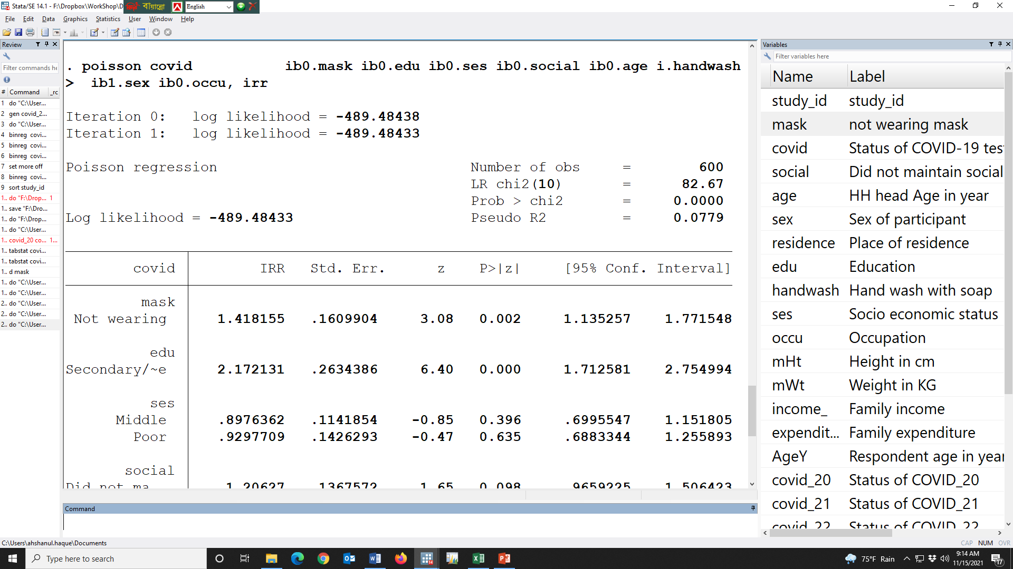

Slide 134
Table ##Risk ratio as the strength of association between several types of COVID status and not wearing mask compare to the people who wore
Several types of COVID status | Unadjusted¹ RR (95% CI) | p-value | Adjusted RR² (95% CI) | p-value
Covid-19 | 1.58 (1.27, 1.97) | 0.000 | 1.42 (1.14, 1.77) | 0.002
Covid-20 | 1.42 (1.13, 1.79) | 0.003 | 1.33 (1.05, 1.67) | 0.018
Covid-21 | 1.41 (1.13, 1.77) | 0.003 | 1.30 (1.03, 1.63) | 0.026
Covid-22 | 1.29 (1.03, 1.62) | 0.024 | 1.19 (0.95, 1.49) | 0.140
Covid-23 | 1.36 (1.08, 1.70) | 0.009 | 1.25 (0.99, 1.57) | 0.058
Covid-24 | 1.40 (1.10, 1.77) | 0.006 | 1.28 (1.00, 1.63) | 0.048
Covid-25 | 1.31 (1.04, 1.65) | 0.020 | 1.19 (0.94, 1.50) | 0.151
Covid-26 | 1.38 (1.09, 1.74) | 0.006 | 1.25 (0.99, 1.59) | 0.058
¹Risk ratios were calculated using simple Poisson regression model for each outcome where several types of COVID status’s were the outcome variables and not wearing mask was the exposure variable; wearing mask was the reference category
²Adjusted for the Education, Socio economic status, Did not maintain social, HH head Age in year, Hand wash with soap, Sex of participant, Occupation in the multiple Poisson model

Slide 135
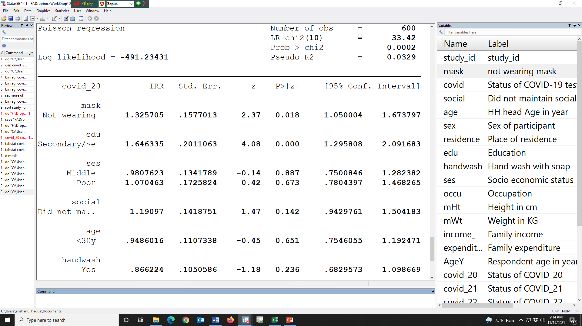

Slide 136
Table ##Risk ratio as the strength of association between several types of COVID status and not wearing mask compare to the people who wore
Several types of COVID status | Unadjusted¹ RR (95% CI) | p-value | Adjusted RR² (95% CI) | p-value
Covid-19 | 1.58 (1.27, 1.97) | 0.000 | 1.42 (1.14, 1.77) | 0.002
Covid-20 | 1.42 (1.13, 1.79) | 0.003 | 1.33 (1.05, 1.67) | 0.018
Covid-21 | 1.41 (1.13, 1.77) | 0.003 | 1.30 (1.03, 1.63) | 0.026
Covid-22 | 1.29 (1.03, 1.62) | 0.024 | 1.19 (0.95, 1.49) | 0.140
Covid-23 | 1.36 (1.08, 1.70) | 0.009 | 1.25 (0.99, 1.57) | 0.058
Covid-24 | 1.40 (1.10, 1.77) | 0.006 | 1.28 (1.00, 1.63) | 0.048
Covid-25 | 1.31 (1.04, 1.65) | 0.020 | 1.19 (0.94, 1.50) | 0.151
Covid-26 | 1.38 (1.09, 1.74) | 0.006 | 1.25 (0.99, 1.59) | 0.058
¹Risk ratios were calculated using simple Poisson regression model for each outcome where several types of COVID status’s were the outcome variables and not wearing mask was the exposure variable; wearing mask was the reference category
²Adjusted for the Education, Socio economic status, Did not maintain social, HH head Age in year, Hand wash with soap, Sex of participant, Occupation in the multiple Poisson model

Slide 137
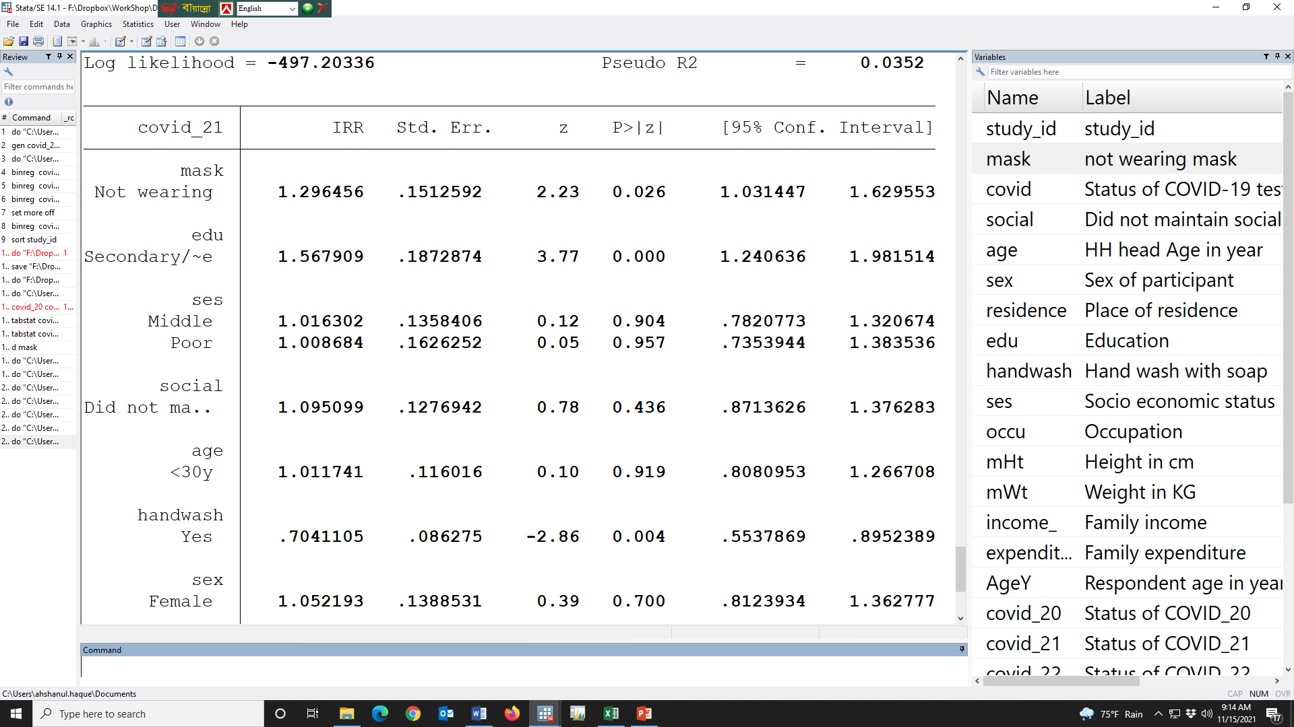

Slide 138
Table ##Risk ratio as the strength of association between several types of COVID status and not wearing mask compare to the people who wore
Several types of COVID status | Unadjusted¹ RR (95% CI) | p-value | Adjusted RR² (95% CI) | p-value
Covid-19 | 1.58 (1.27, 1.97) | 0.000 | 1.42 (1.14, 1.77) | 0.002
Covid-20 | 1.42 (1.13, 1.79) | 0.003 | 1.33 (1.05, 1.67) | 0.018
Covid-21 | 1.41 (1.13, 1.77) | 0.003 | 1.30 (1.03, 1.63) | 0.026
Covid-22 | 1.29 (1.03, 1.62) | 0.024 | 1.19 (0.95, 1.49) | 0.140
Covid-23 | 1.36 (1.08, 1.70) | 0.009 | 1.25 (0.99, 1.57) | 0.058
Covid-24 | 1.40 (1.10, 1.77) | 0.006 | 1.28 (1.00, 1.63) | 0.048
Covid-25 | 1.31 (1.04, 1.65) | 0.020 | 1.19 (0.94, 1.50) | 0.151
Covid-26 | 1.38 (1.09, 1.74) | 0.006 | 1.25 (0.99, 1.59) | 0.058
¹Risk ratios were calculated using simple Poisson regression model for each outcome where several types of COVID status’s were the outcome variables and not wearing mask was the exposure variable; wearing mask was the reference category
²Adjusted for the Education, Socio economic status, Did not maintain social, HH head Age in year, Hand wash with soap, Sex of participant, Occupation in the multiple Poisson model

Slide 139
Table ##Risk ratio as the strength of association between several types of COVID status and not wearing mask compare to the people who wore
Several types of COVID status | Unadjusted¹ RR (95% CI) | p-value | Adjusted RR² (95% CI) | p-value
Covid-19 | 1.58 (1.27, 1.97) | 0.000 | 1.42 (1.14, 1.77) | 0.002
Covid-20 | 1.42 (1.13, 1.79) | 0.003 | 1.33 (1.05, 1.67) | 0.018
Covid-21 | 1.41 (1.13, 1.77) | 0.003 | 1.30 (1.03, 1.63) | 0.026
Covid-22 | 1.29 (1.03, 1.62) | 0.024 | 1.19 (0.95, 1.49) | 0.140
Covid-23 | 1.36 (1.08, 1.70) | 0.009 | 1.25 (0.99, 1.57) | 0.058
Covid-24 | 1.40 (1.10, 1.77) | 0.006 | 1.28 (1.00, 1.63) | 0.048
Covid-25 | 1.31 (1.04, 1.65) | 0.020 | 1.19 (0.94, 1.50) | 0.151
Covid-26 | 1.38 (1.09, 1.74) | 0.006 | 1.25 (0.99, 1.59) | 0.058
¹Risk ratios were calculated using simple Poisson regression model for each outcome where several types of COVID status’s were the outcome variables and not wearing mask was the exposure variable; wearing mask was the reference category
²Adjusted for the Education, Socio economic status, Did not maintain social, HH head Age in year, Hand wash with soap, Sex of participant, Occupation in the multiple Poisson model

